Slide 1
Lecture 6: The advection equation
Omer Bromberg
omerbr@tauex.tau.ac.il
Winter 2025/6
Modified from lecture notes by Cyrus Dreyer & Michael Zingale

Slide 2
Partial differential equations
Ordinary differential equations (ODE) – 1D solutions
Partial differential equations (PDE) – nD solutions.
Much of the physics is involves in solving PDE equations
Schrodinger equation in Quantum mechanics
Maxwell’s equations in electricity and magnetism
Wave equation in optics and acoustics
Advection equations
Hydrodynamic and magneto-hydrodynamic equations.
For ODEs we developed general methods to solve a variety of problems, e.g. 4’th order Runge-Kutta, leapfrog.
For PDEs, we first need to classify the type of equation involved, and then choose what method to use.

Slide 3
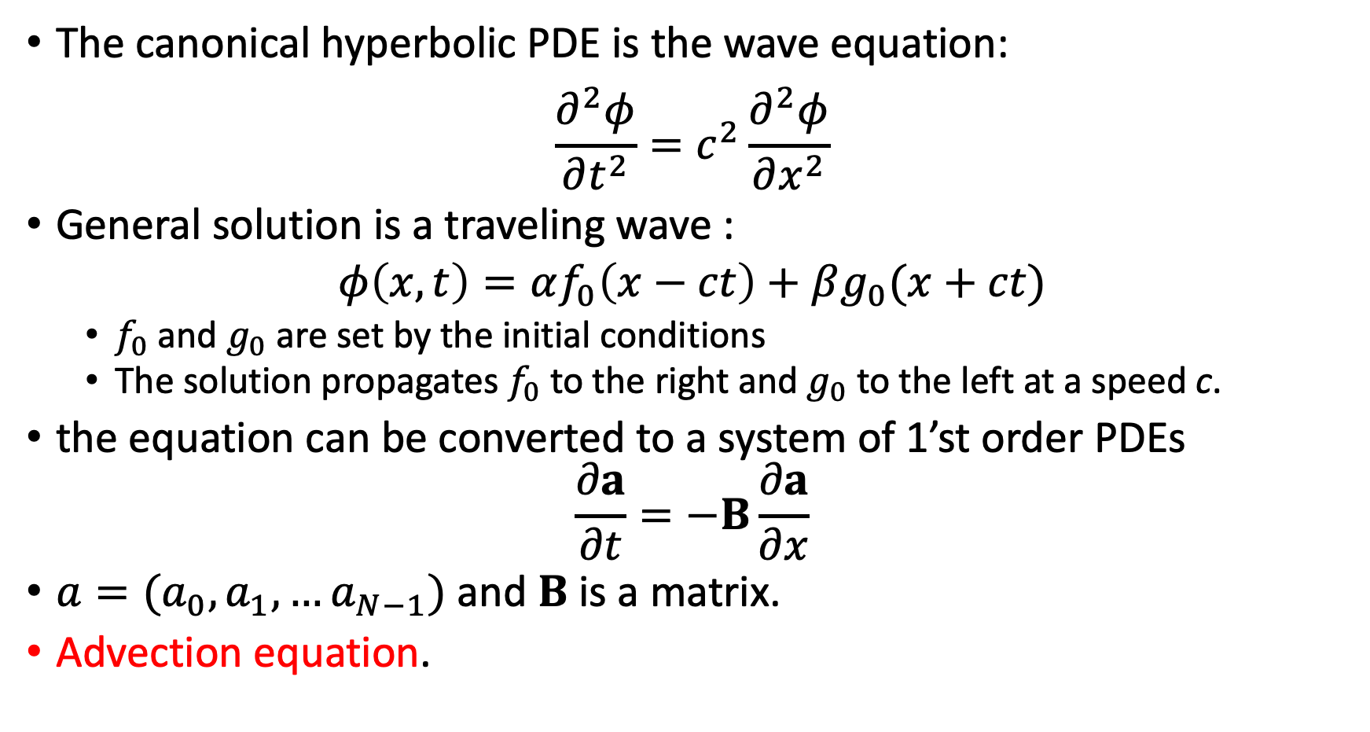
Hyperbolic PDEs
The canonical hyperbolic PDE is the wave equation:
$$\frac{∂^{2}φ}{∂t^{2}}=c^{2}\frac{∂^{2}φ}{∂x^{2}}$$
General solution is a traveling wave :
$$φ\left(x,t\right)=αf_{0}\left(x−ct\right)+βg_{0}(x+ct)$$
$f_{0}$ and $g_{0}$ are set by the initial conditions
The solution propagates $f_{0}$ to the right and $g_{0}$ to the left at a speed c.
the equation can be converted to a system of 1’st order PDEs
$$\frac{∂a}{∂t}=−B\frac{∂a}{∂x}$$
$a=(a_{0},a_{1},…a_{N−1})$ and $B$ is a matrix.
Advection equation.
Notes:
for example x=Acos (x-ct) ; v=dx/dt=cA sin(x-ct) ; dv/dt = -c^2A cos(x-ct) = -c dv/dx

Slide 4
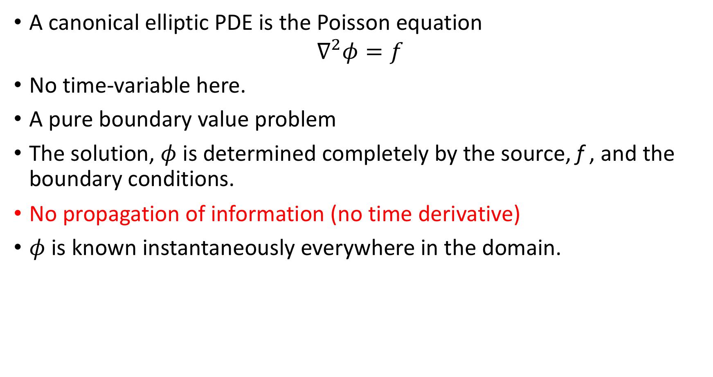
Elliptic PDEs
A canonical elliptic PDE is the Poisson equation
$$∇^{2}φ=f$$
No time-variable here.
A pure boundary value problem
The solution, $φ$ is determined completely by the source, f , and the boundary conditions.
No propagation of information (no time derivative)
$φ$ is known instantaneously everywhere in the domain.

Slide 5
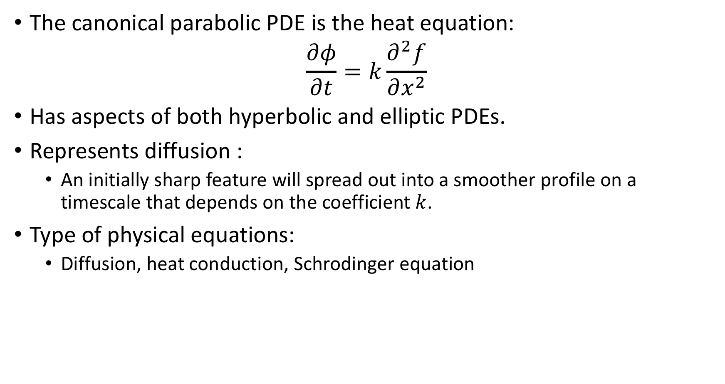
Parabolic PDEs
The canonical parabolic PDE is the heat equation:
$$\frac{∂φ}{∂t}=k\frac{∂^{2}f}{∂x^{2}}$$
Has aspects of both hyperbolic and elliptic PDEs.
Represents diffusion :
An initially sharp feature will spread out into a smoother profile on a timescale that depends on the coefficient $k$.
Type of physical equations:
Diffusion, heat conduction, Schrodinger equation

Slide 6
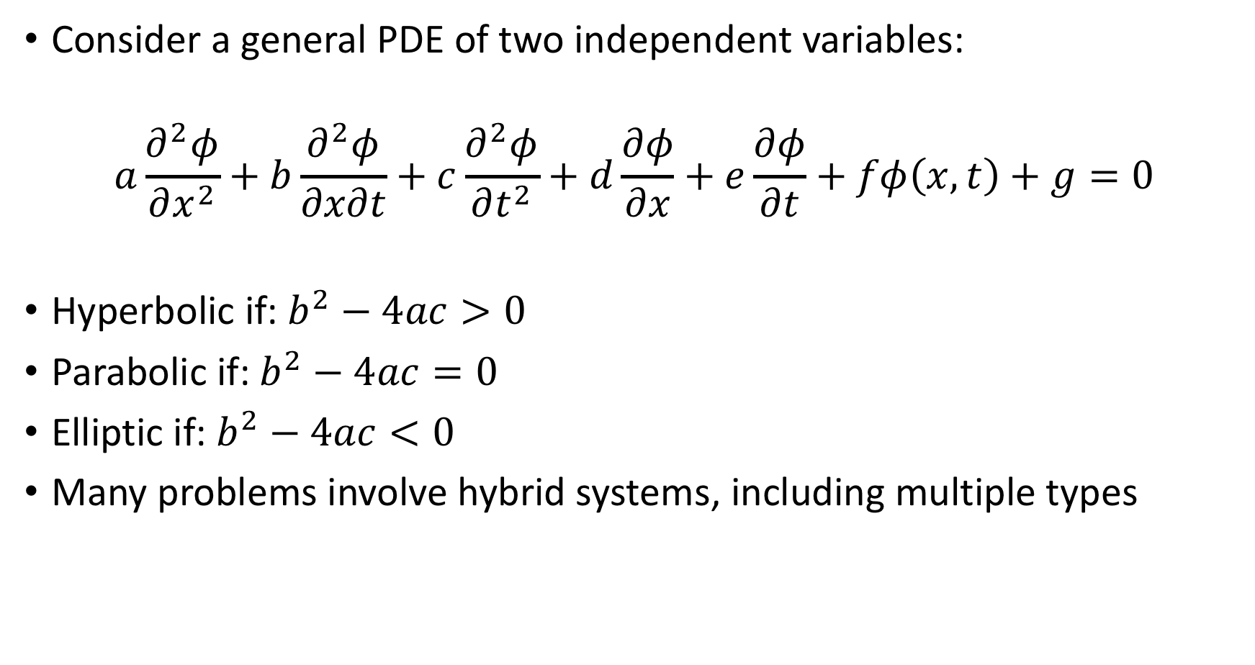
General classification of PDEs
Consider a general PDE of two independent variables:
$$a\frac{∂^{2}φ}{∂x^{2}}+b\frac{∂^{2}φ}{∂x∂t}+c\frac{∂^{2}φ}{∂t^{2}}+d\frac{∂φ}{∂x}+e\frac{∂φ}{∂t}+fφ\left(x,t\right)+g=0$$
Hyperbolic if: $b^{2}−4ac>0$
Parabolic if: $b^{2}−4ac=0$
Elliptic if: $b^{2}−4ac<0$
Many problems involve hybrid systems, including multiple types

Slide 7
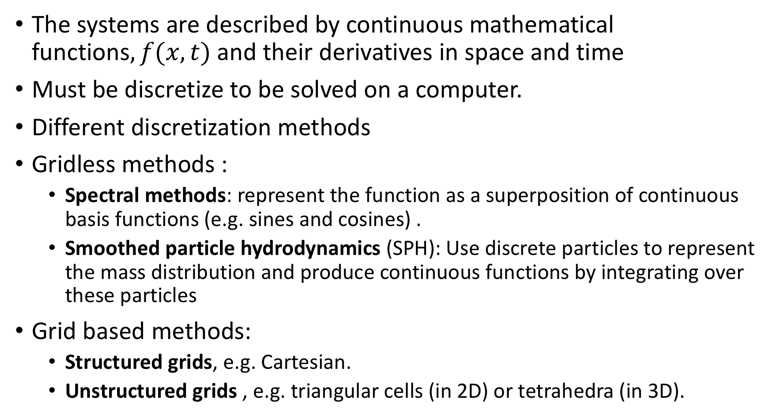
Discretization methods
The systems are described by continuous mathematical functions$, f(x, t)$and their derivatives in space and time
Must be discretize to be solved on a computer.
Different discretization methods
Gridless methods :
Spectral methods: represent the function as a superposition of continuous basis functions (e.g. sines and cosines) .
Smoothed particle hydrodynamics (SPH): Use discrete particles to represent the mass distribution and produce continuous functions by integrating over these particles
Grid based methods:
Structured grids, e.g. Cartesian.
Unstructured grids , e.g. triangular cells (in 2D) or tetrahedra (in 3D).

Slide 8
Grid basics
In astrophysics we typically use structured grids.
Logically Cartesian grids - position on the grid can be specified by a single integer index in each dimension.
Two main types of structured grids:
Finite difference: The discrete data is associated with specific points of the function in space.
Finite Volume: The discrete data is represented by averages over a control volume.

Slide 9
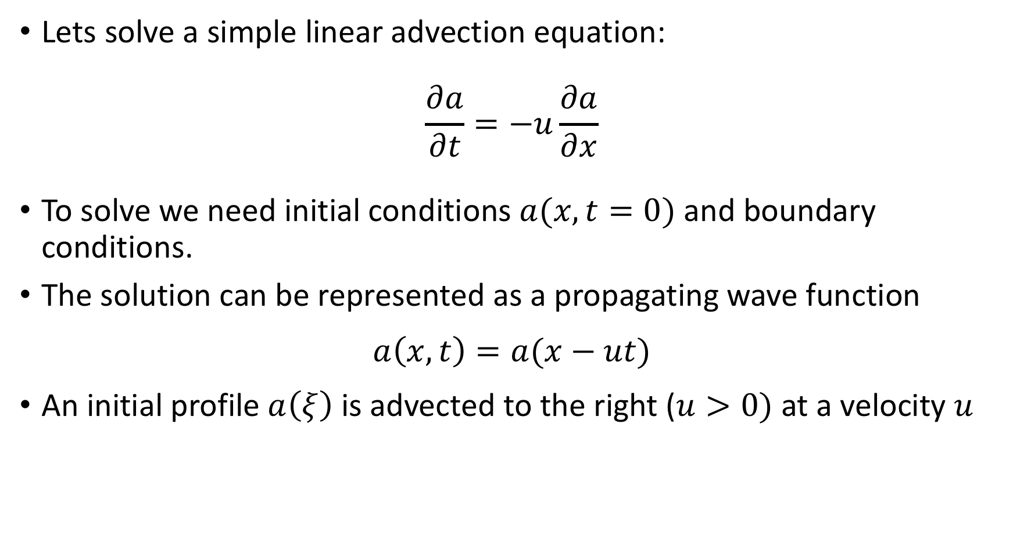
Linear advection in finite difference grids
Lets solve a simple linear advection equation:
$$\frac{∂a}{∂t}=−u\frac{∂a}{∂x}$$
To solve we need initial conditions $a(x,t=0)$ and boundary conditions.
The solution can be represented as a propagating wave function
$$a\left(x,t\right)=a(x−ut)$$
An initial profile $a\left(ξ\right)$ is advected to the right ($u>0)$ at a velocity $u$
https://zingale.github.io/comp_astro_tutorial/advection_euler/advection/advection.html

Slide 10
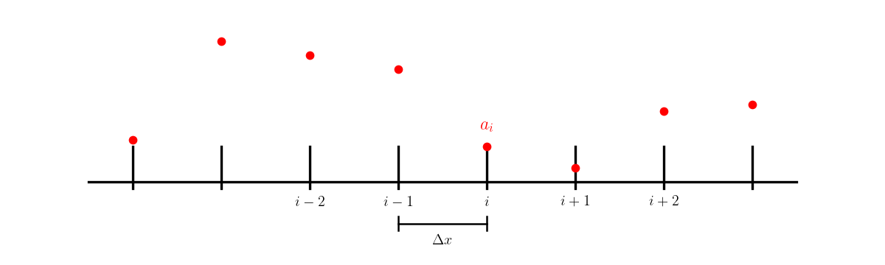
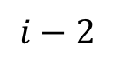
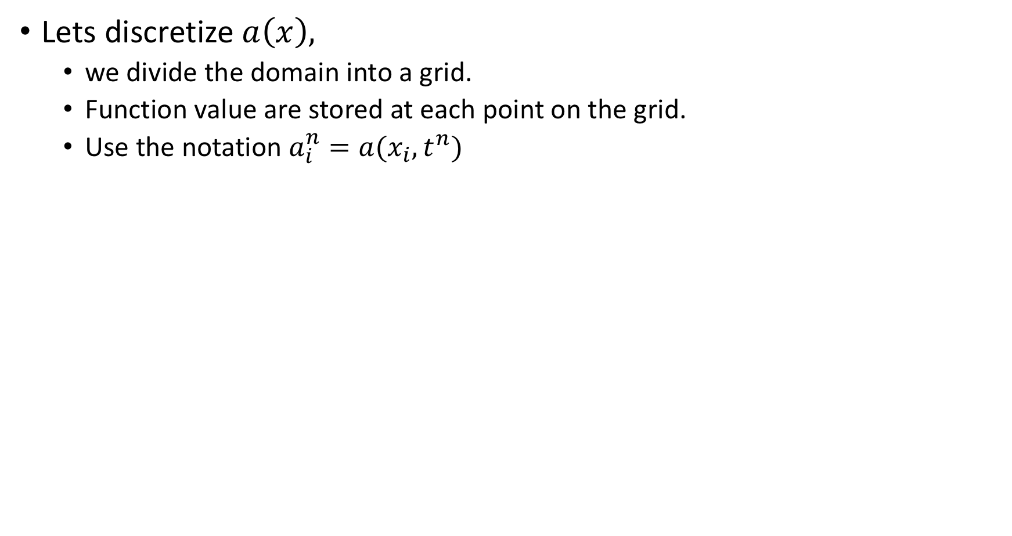
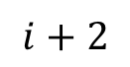
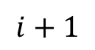
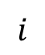
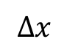
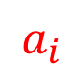
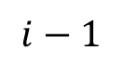
Linear advection in finite difference grids
Lets discretize $a\left(x\right),$
we divide the domain into a grid.
Function value are stored at each point on the grid.
Use the notation $a_{i}^{n}=a(x_{i},t^{n})$
$$a_{i}$$
$$i−2$$
$$i−1$$
$$i$$
$$i+1$$
$$i+2$$
$$Δx$$

Slide 11
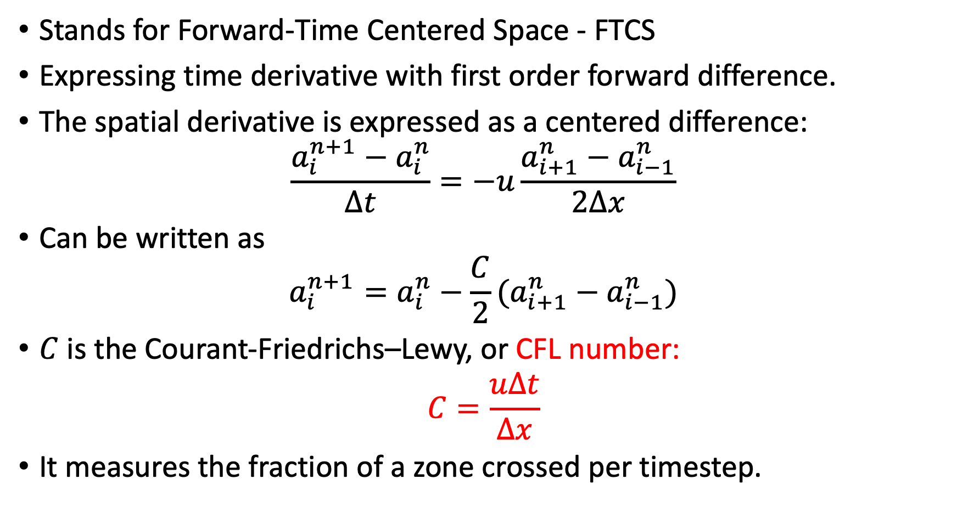
The FTCS method
Stands for Forward-Time Centered Space - FTCS
Expressing time derivative with first order forward difference.
The spatial derivative is expressed as a centered difference:
$$\frac{a_{i}^{n+1}−a_{i}^{n}}{Δt}=−u\frac{a_{i+1}^{n}−a_{i−1}^{n}}{2Δx}$$
Can be written as
$$a_{i}^{n+1}=a_{i}^{n}−\frac{C}{2}(a_{i+1}^{n}−a_{i−1}^{n})$$
$C$ is the Courant-Friedrichs–Lewy, or CFL number:
$$C=\frac{uΔt}{Δx}$$
It measures the fraction of a zone crossed per timestep.

Slide 12
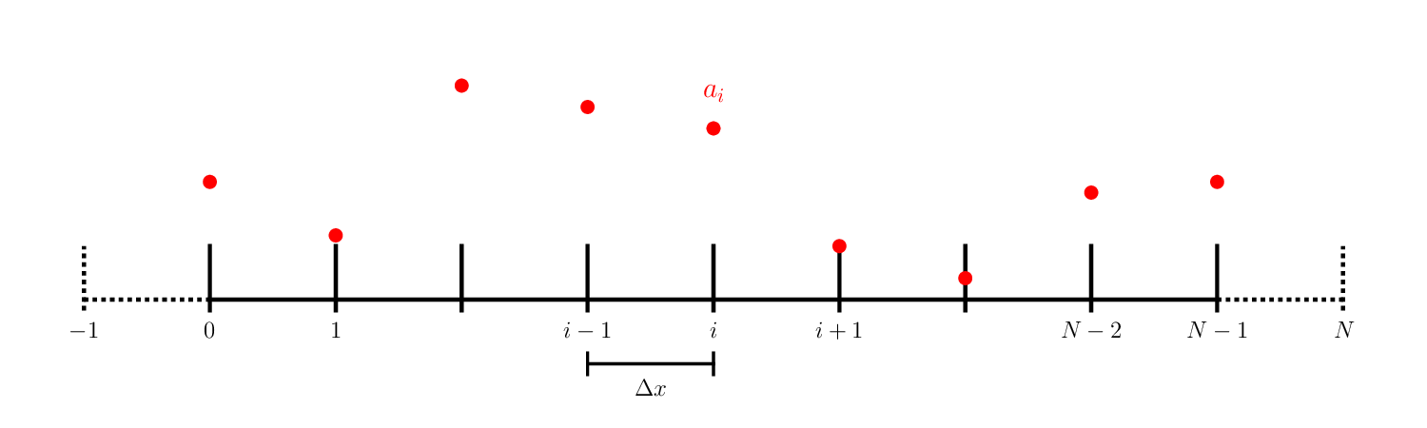
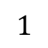
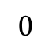
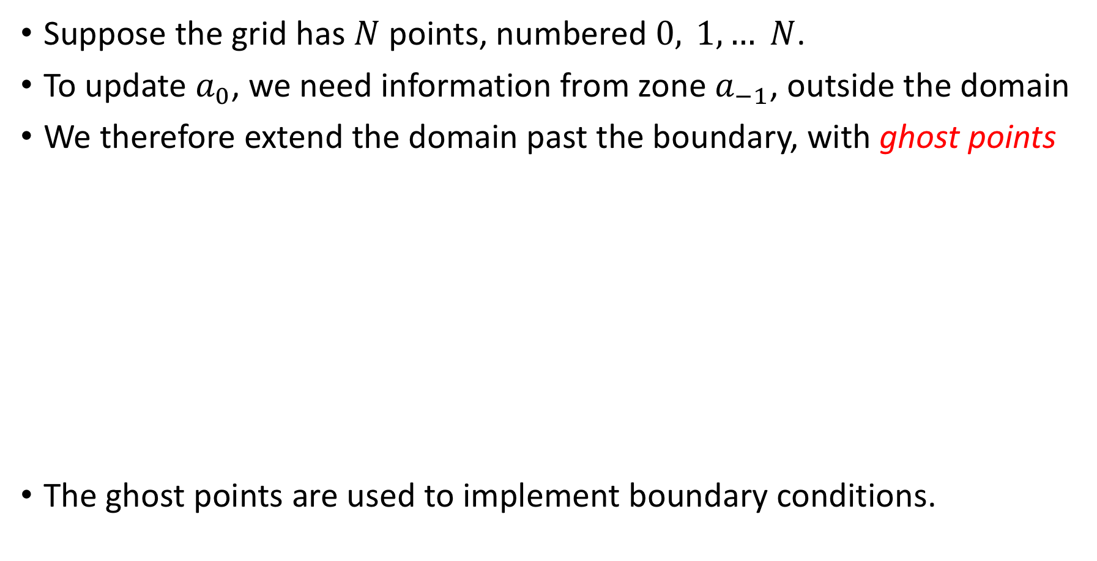
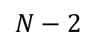
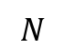
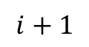
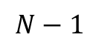
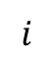
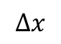
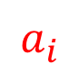
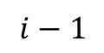
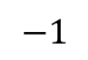
Boundary conditions and ghost cells
Suppose the grid has $N$ points, numbered $0, 1, … N$.
To update $a_{0}$, we need information from zone $a_{−1}$, outside the domain
We therefore extend the domain past the boundary, with ghost points
The ghost points are used to implement boundary conditions.
$$a_{i}$$
$$−1$$
$$0$$
$$1$$
$$i−1$$
$$i$$
$$i+1$$
$$N−2$$
$$N−1$$
$$N$$
$$Δx$$

Slide 13
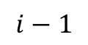
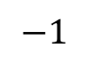
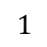
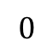
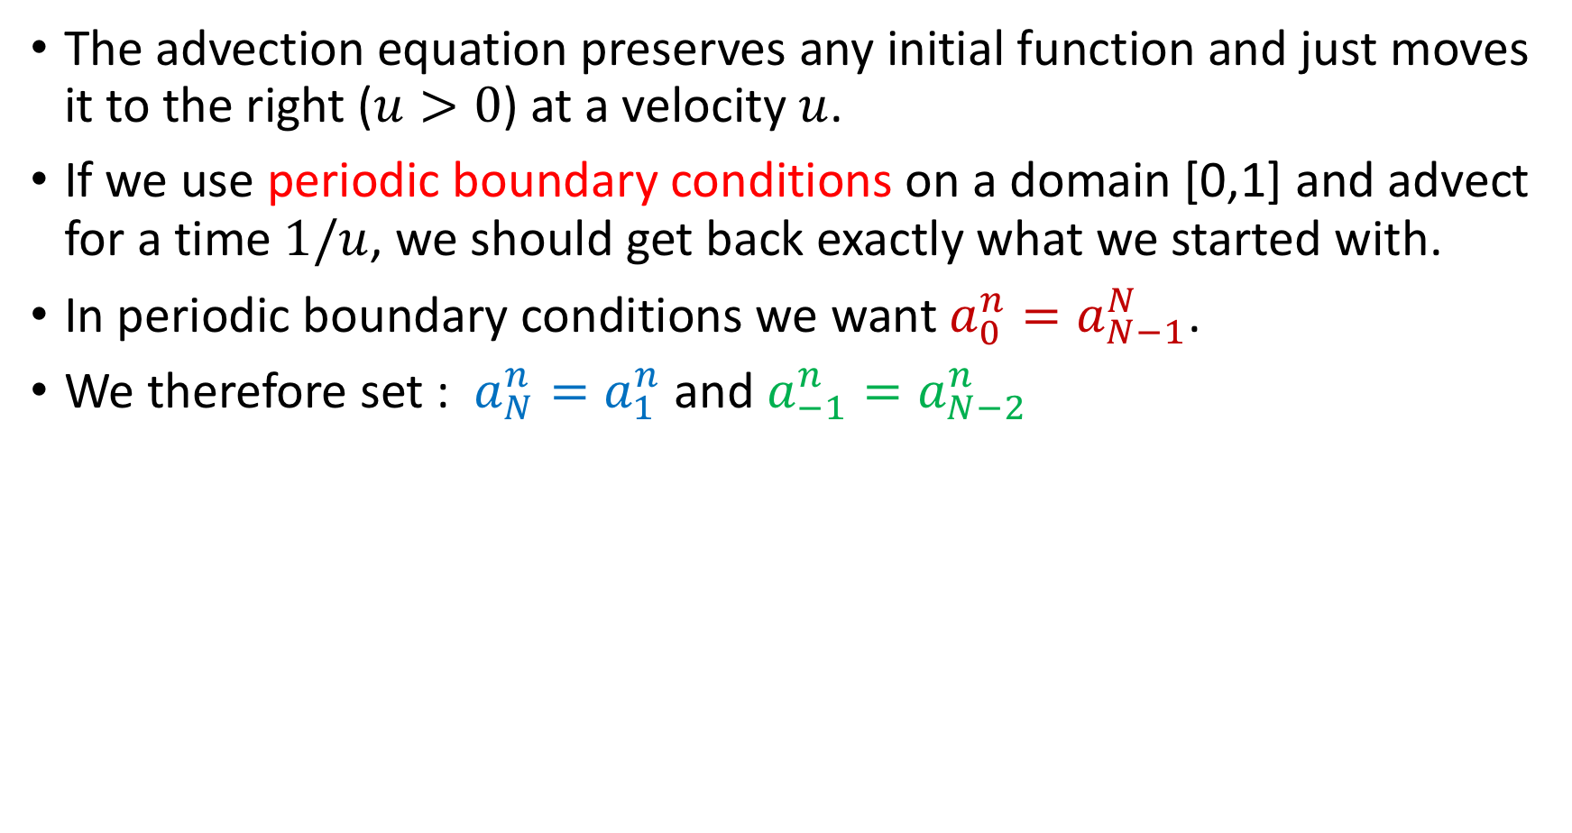
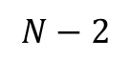
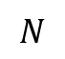
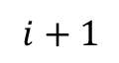
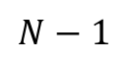
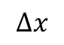
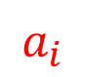
Boundary conditions and ghost cells -periodic
The advection equation preserves any initial function and just moves it to the right ($u>0$) at a velocity $u$.
If we use periodic boundary conditions on a domain [0,1] and advect for a time $1/u$, we should get back exactly what we started with.
In periodic boundary conditions we want $a_{0}^{n}=a_{N−1}^{N}$.
We therefore set : $a_{N}^{n}=a_{1}^{n}$ and $a_{−1}^{n}=a_{N−2}^{n}$
$$a_{i}$$
$$−1$$
$$0$$
$$1$$
$$i−1$$
$$i$$
$$i+1$$
$$N−2$$
$$N−1$$
$$N$$
$$Δx$$

Slide 14
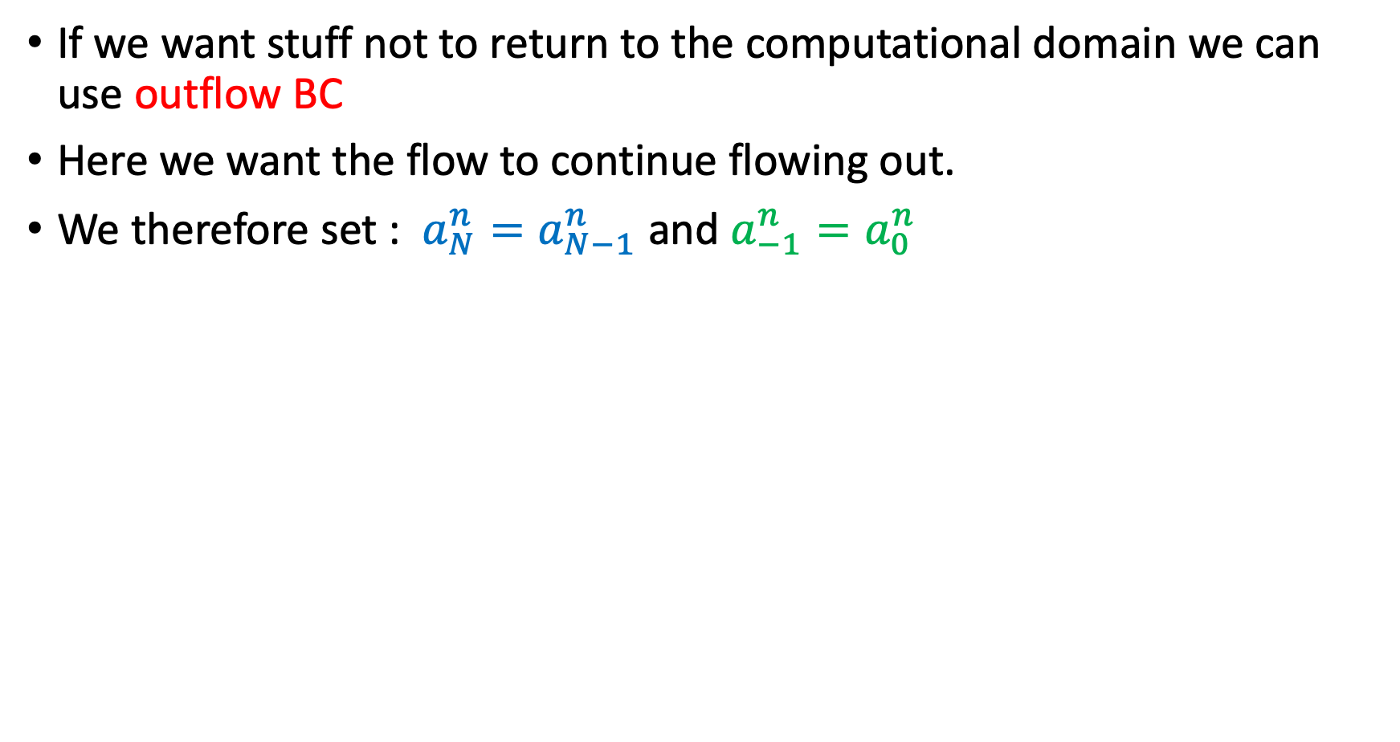
Boundary conditions and ghost cells - outflow
If we want stuff not to return to the computational domain we can use outflow BC
Here we want the flow to continue flowing out.
We therefore set : $a_{N}^{n}=a_{N−1}^{n}$ and $a_{−1}^{n}=a_{0}^{n}$
$$a_{i}$$
$$−1$$
$$0$$
$$1$$
$$i−1$$
$$i$$
$$i+1$$
$$N−2$$
$$N−1$$
$$N$$
$$Δx$$

Slide 15
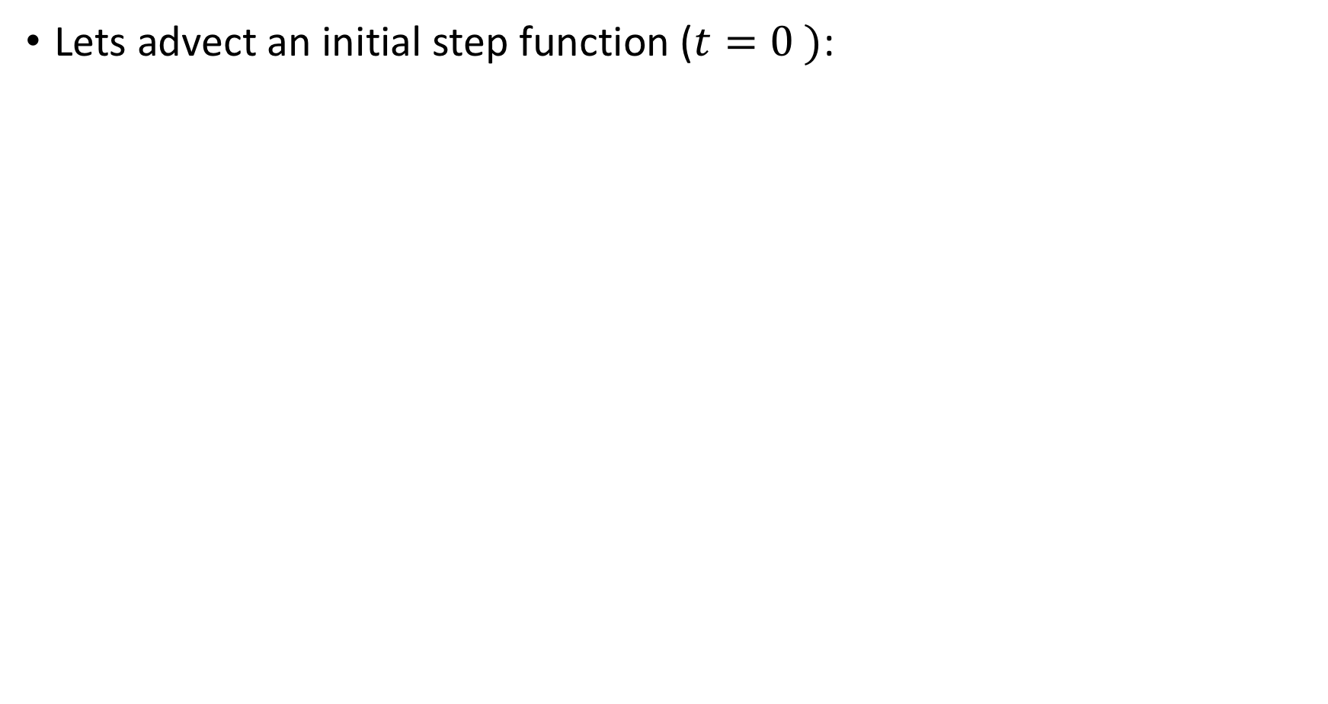
Test problem
Lets advect an initial step function ($t=0 )$:
Simulation source: M.Z. course AST390

Slide 16
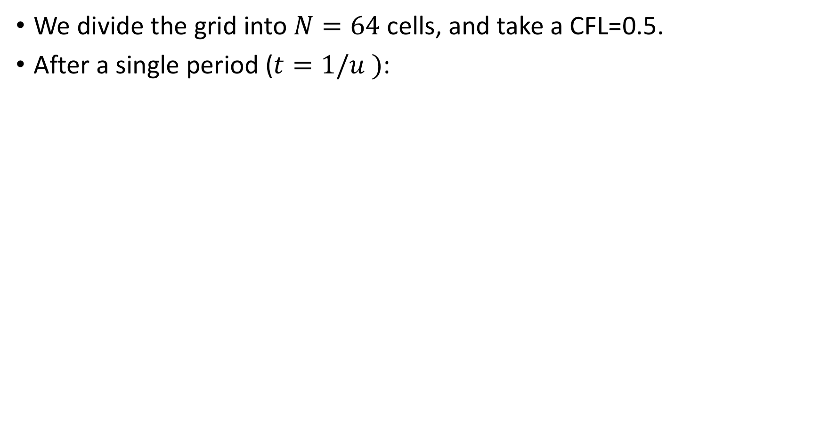
Test problem
We divide the grid into $N=64$ cells, and take a CFL=0.5.
After a single period ($t=1/u )$:
Notes:
That looks really bad! Remember, if we did well, then the solution after one period should look just like the initial conditions!
We know that our difference approximations should be more accurate for smaller Δt and smaller Δx. Reducing Δt is equivalent to picking a smaller value of CFL. So let’s try that.

Slide 17
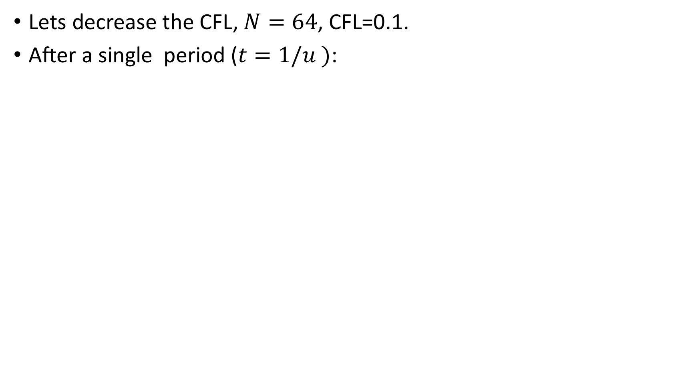
Test problem
Lets decrease the CFL, $N=64$, CFL=0.1.
After a single period ($t=1/u )$:
Notes:
That’s still really bad. Let’s try evolving for less time:

Slide 18
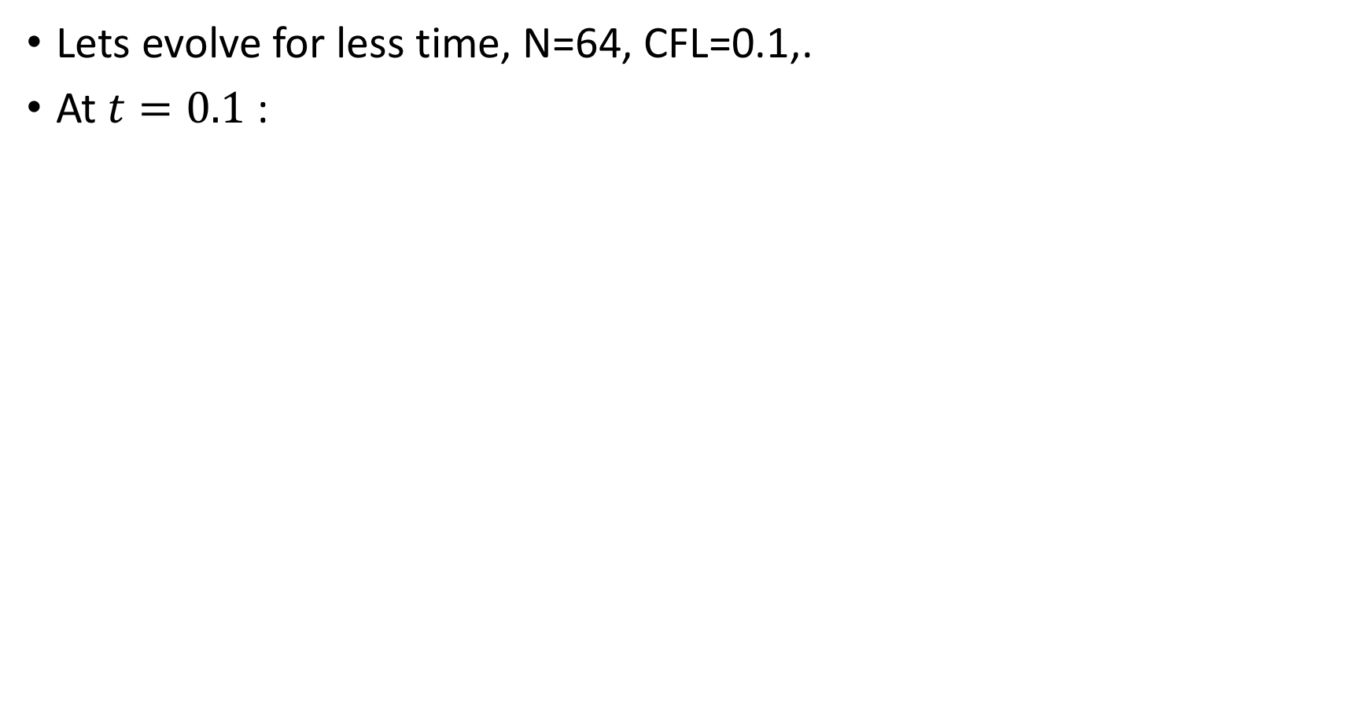
Test problem
Lets evolve for less time, N=64, CFL=0.1,.
At $t=0.1$:
Notes:
That shows that something is happening near the discontinuities. Maybe we need more resolution?

Slide 19
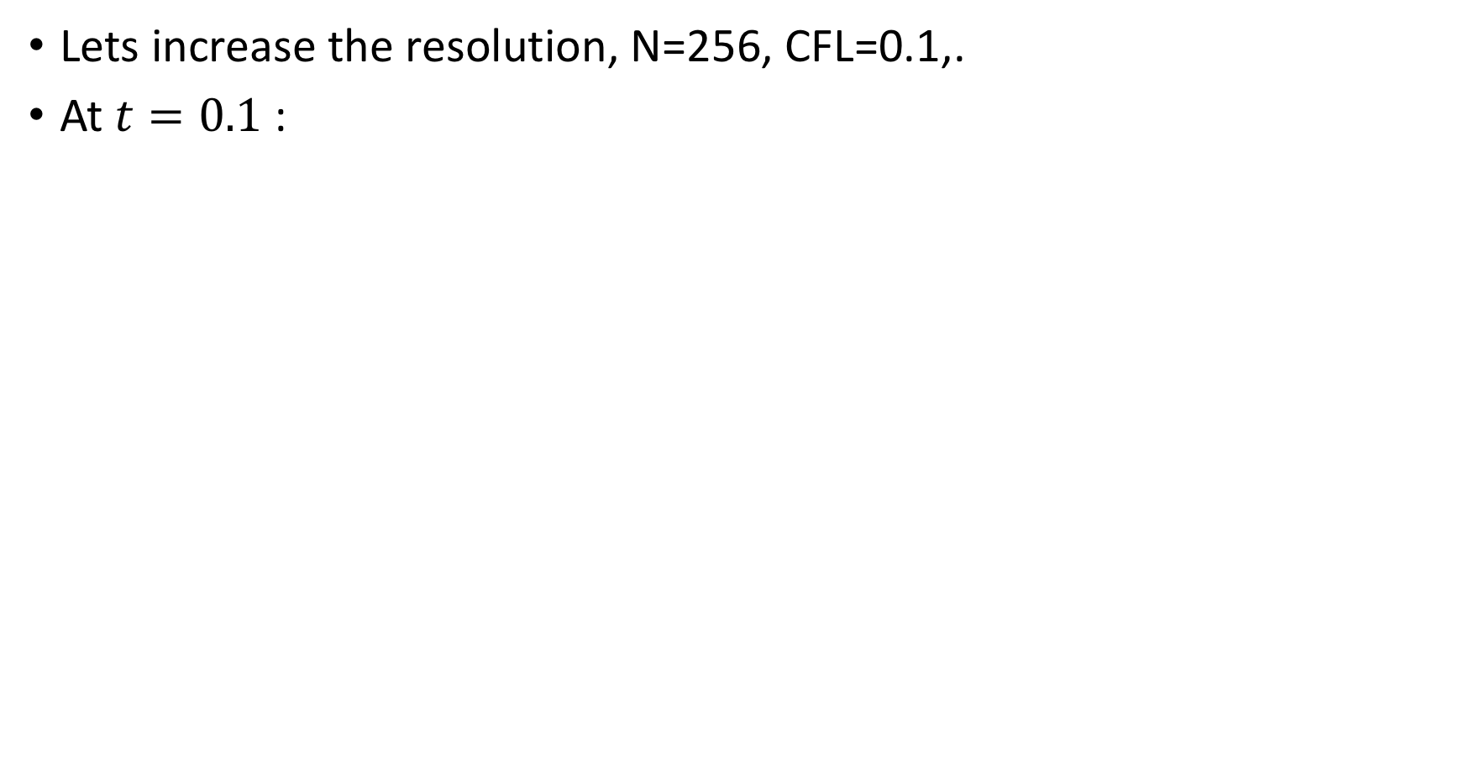
Test problem
Lets increase the resolution, N=256, CFL=0.1,.
At $t=0.1$:
Notes:
The issue is that the FTCS method is unstable. There are different ways that we can analyze this. We’ll do a truncation analysis.

Slide 20
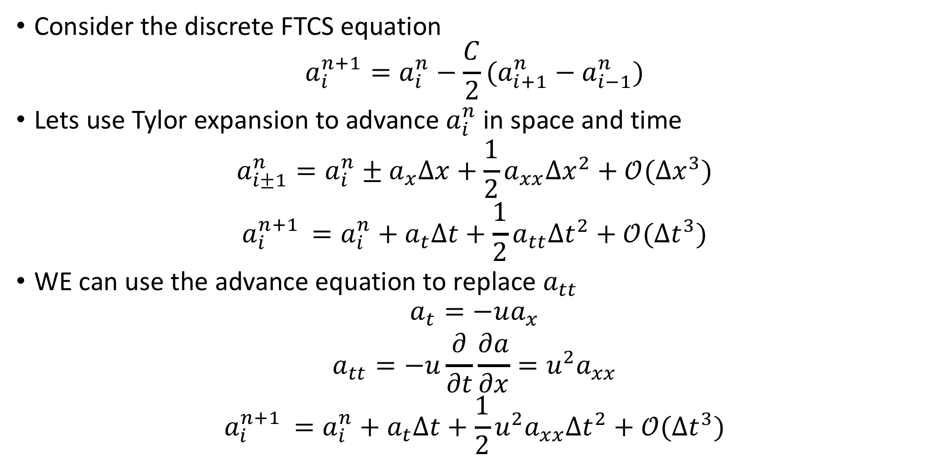
FTCS stability
Consider the discrete FTCS equation
$$a_{i}^{n+1}=a_{i}^{n}−\frac{C}{2}(a_{i+1}^{n}−a_{i−1}^{n})$$
Lets use Tylor expansion to advance $a_{i}^{n}$in space and time
$$a_{i±1}^{n}=a_{i}^{n}±a_{x}Δx+\frac{1}{2}a_{xx}Δx^{2}+𝒪(Δx^{3})$$
$$a_{i}^{n+1 }=a_{i}^{n}+a_{t}Δt+\frac{1}{2}a_{tt}Δt^{2}+𝒪(Δt^{3})$$
WE can use the advance equation to replace $a_{tt}$
$$a_{t}=−ua_{x}$$
$$a_{tt}=−u\frac{∂}{∂t}\frac{∂a}{∂x}=u^{2}a_{xx}$$
$$a_{i}^{n+1 }=a_{i}^{n}+a_{t}Δt+\frac{1}{2}u^{2}a_{xx}Δt^{2}+𝒪(Δt^{3})$$

Slide 21
FTCS stability
Consider the discrete FTCS equation
$$a_{i}^{n+1}=a_{i}^{n}−\frac{C}{2}(a_{i+1}^{n}−a_{i−1}^{n})$$
Lets use Tylor expansion to advance $a_{i}^{n}$in space and time
$$a_{i±1}^{n}=a_{i}^{n}±a_{x}Δx+\frac{1}{2}a_{xx}Δx^{2}+𝒪(Δx^{3})$$
$$a_{i}^{n+1 }=a_{i}^{n}+a_{t}Δt+\frac{1}{2}a_{tt}Δt^{2}+𝒪(Δt^{3})$$
WE can use the advance equation to replace $a_{tt}$
$$a_{t}=−ua_{x}$$
$$a_{tt}=−u\frac{∂}{∂t}\frac{∂a}{∂x}=u^{2}a_{xx}$$
$$a_{i}^{n+1 }=a_{i}^{n}+a_{t}Δt+\frac{1}{2}u^{2}a_{xx}Δt^{2}+𝒪(Δt^{3})$$

Slide 22
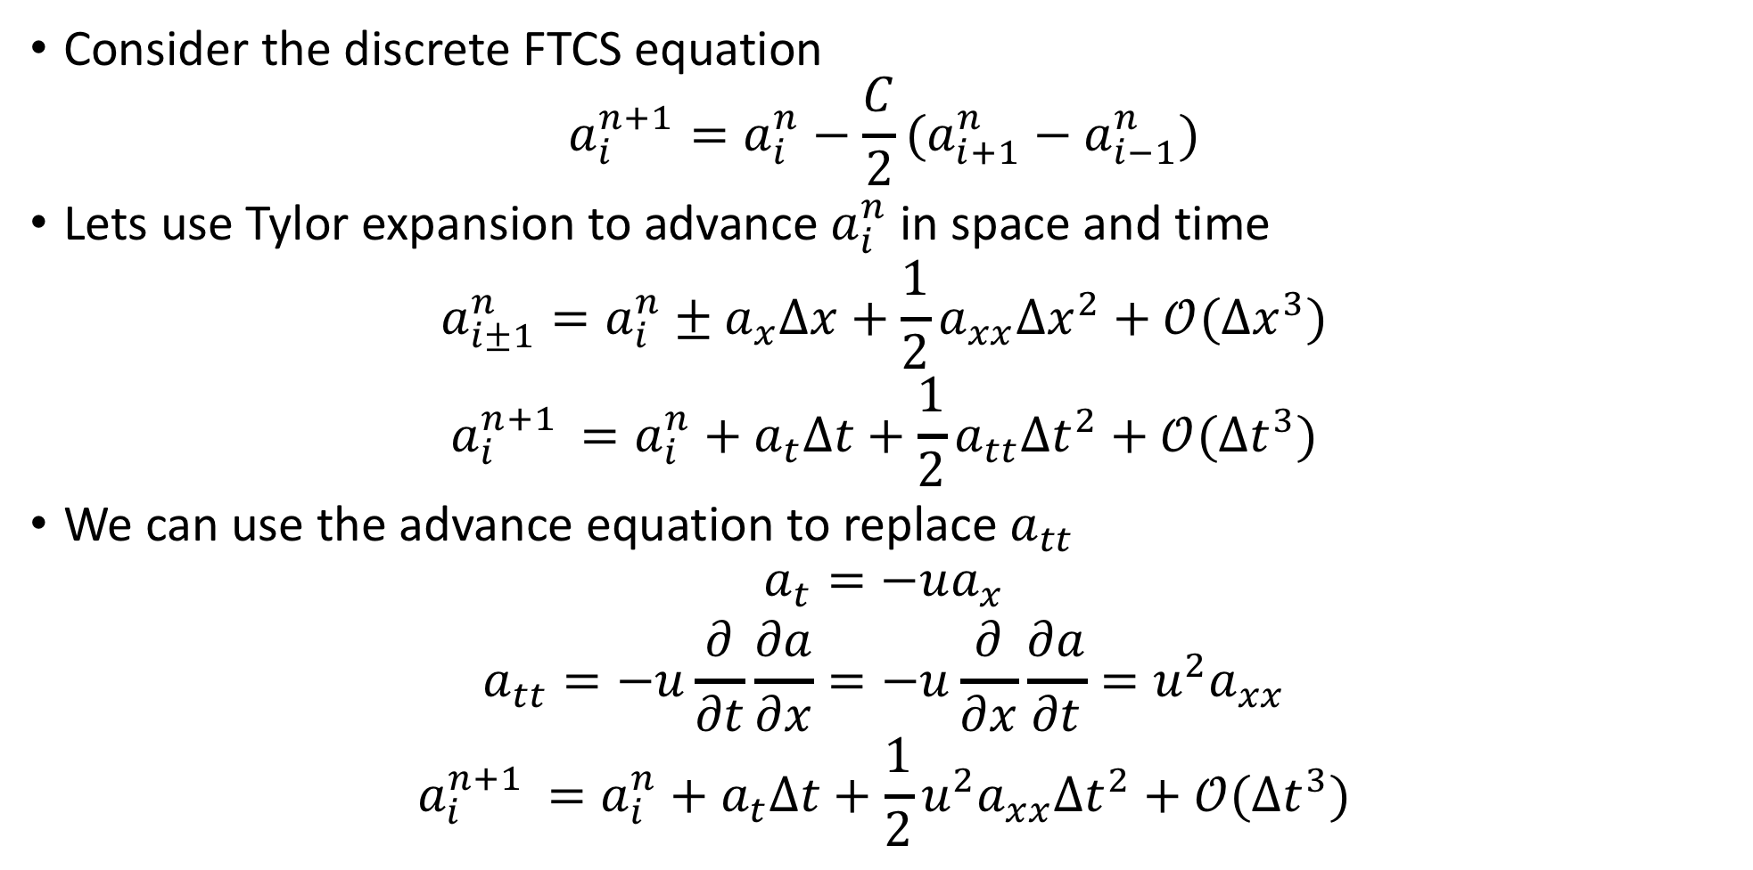
FTCS stability
Consider the discrete FTCS equation
$$a_{i}^{n+1}=a_{i}^{n}−\frac{C}{2}(a_{i+1}^{n}−a_{i−1}^{n})$$
Lets use Tylor expansion to advance $a_{i}^{n}$in space and time
$$a_{i±1}^{n}=a_{i}^{n}±a_{x}Δx+\frac{1}{2}a_{xx}Δx^{2}+𝒪(Δx^{3})$$
$$a_{i}^{n+1 }=a_{i}^{n}+a_{t}Δt+\frac{1}{2}a_{tt}Δt^{2}+𝒪(Δt^{3})$$
We can use the advance equation to replace $a_{tt}$
$$a_{t}=−ua_{x}$$
$$a_{tt}=−u\frac{∂}{∂t}\frac{∂a}{∂x}={−u\frac{∂}{∂x}\frac{∂a}{∂t}=u}^{2}a_{xx}$$
$$a_{i}^{n+1 }=a_{i}^{n}+a_{t}Δt+\frac{1}{2}u^{2}a_{xx}Δt^{2}+𝒪(Δt^{3})$$

Slide 23
FTCS stability
Consider the discrete FTCS equation
$$a_{i}^{n+1}=a_{i}^{n}−\frac{C}{2}(a_{i+1}^{n}−a_{i−1}^{n})$$
Lets use Tylor expansion to advance $a_{i}^{n}$in space and time
$$a_{i±1}^{n}=a_{i}^{n}±a_{x}Δx+\frac{1}{2}a_{xx}Δx^{2}+𝒪(Δx^{3})$$
$$a_{i}^{n+1 }=a_{i}^{n}+a_{t}Δt+\frac{1}{2}a_{tt}Δt^{2}+𝒪(Δt^{3})$$
We can use the advance equation to replace $a_{tt}$
$$a_{t}=−ua_{x}$$
$$a_{tt}=−u\frac{∂}{∂t}\frac{∂a}{∂x}={−u\frac{∂}{∂x}\frac{∂a}{∂t}=u}^{2}a_{xx}$$
$$a_{i}^{n+1 }=a_{i}^{n}+a_{t}Δt+\frac{1}{2}u^{2}a_{xx}Δt^{2}+𝒪(Δt^{3})$$

Slide 24
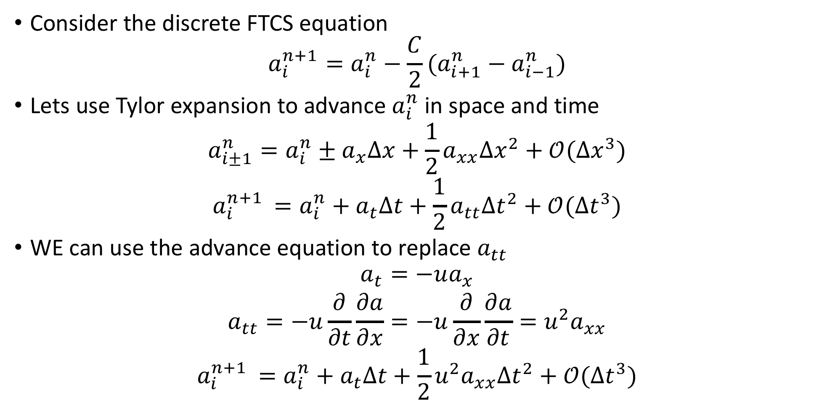
FTCS stability
Consider the discrete FTCS equation
$$a_{i}^{n+1}=a_{i}^{n}−\frac{C}{2}(a_{i+1}^{n}−a_{i−1}^{n})$$
Lets use Tylor expansion to advance $a_{i}^{n}$in space and time
$$a_{i±1}^{n}=a_{i}^{n}±a_{x}Δx+\frac{1}{2}a_{xx}Δx^{2}+𝒪(Δx^{3})$$
$$a_{i}^{n+1 }=a_{i}^{n}+a_{t}Δt+\frac{1}{2}a_{tt}Δt^{2}+𝒪(Δt^{3})$$
WE can use the advance equation to replace $a_{tt}$
$$a_{t}=−ua_{x}$$
$$a_{tt}=−u\frac{∂}{∂t}\frac{∂a}{∂x}={−u\frac{∂}{∂x}\frac{∂a}{∂t}=u}^{2}a_{xx}$$
$$a_{i}^{n+1 }=a_{i}^{n}+a_{t}Δt+\frac{1}{2}u^{2}a_{xx}Δt^{2}+𝒪(Δt^{3})$$

Slide 25
FTCS stability
Consider the discrete FTCS equation
$$a_{i}^{n+1}=a_{i}^{n}−\frac{C}{2}(a_{i+1}^{n}−a_{i−1}^{n})$$
Lets use Tylor expansion to advance $a_{i}^{n}$in space and time
$$a_{i±1}^{n}=a_{i}^{n}±a_{x}Δx+\frac{1}{2}a_{xx}Δx^{2}+𝒪(Δx^{3})$$
$$a_{i}^{n+1 }=a_{i}^{n}+a_{t}Δt+\frac{1}{2}a_{tt}Δt^{2}+𝒪(Δt^{3})$$
WE can use the advance equation to replace $a_{tt}$
$$a_{t}=−ua_{x}$$
$$a_{tt}=−u\frac{∂}{∂t}\frac{∂a}{∂x}={−u\frac{∂}{∂x}\frac{∂a}{∂t}=u}^{2}a_{xx}$$
$$a_{i}^{n+1 }=a_{i}^{n}+a_{t}Δt+\frac{1}{2}u^{2}a_{xx}Δt^{2}+𝒪(Δt^{3})$$

Slide 26
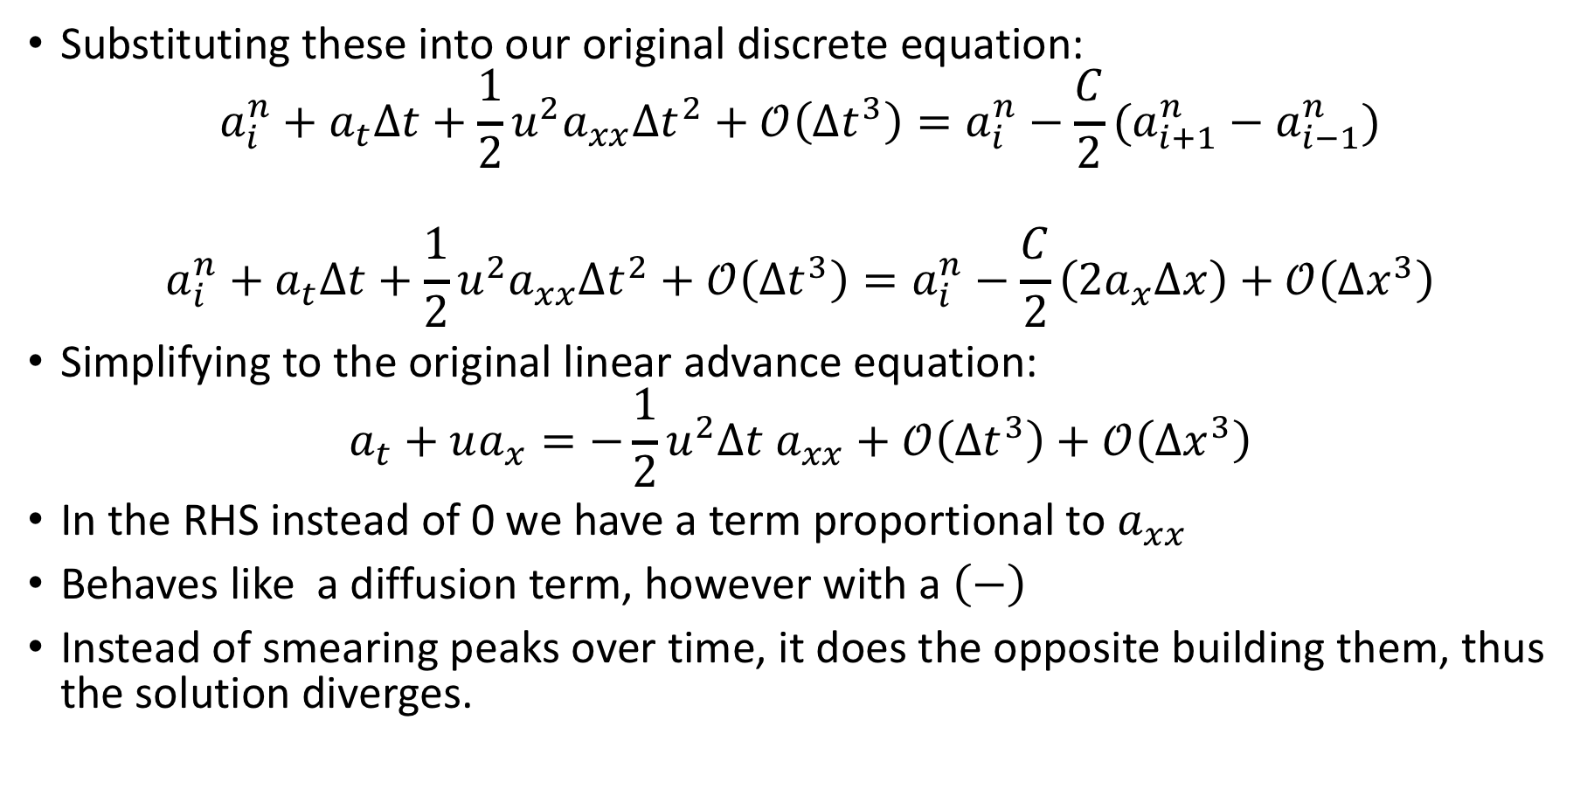
FTCS stability
Substituting these into our original discrete equation:
$$a_{i}^{n}+a_{t}Δt+\frac{1}{2}u^{2}a_{xx}Δt^{2}+𝒪\left(Δt^{3}\right)=a_{i}^{n}−\frac{C}{2}(a_{i+1}^{n}−a_{i−1}^{n})$$
$$a_{i}^{n}+a_{t}Δt+\frac{1}{2}u^{2}a_{xx}Δt^{2}+𝒪\left(Δt^{3}\right)=a_{i}^{n}−\frac{C}{2}\left(2a_{x}Δx\right)+𝒪\left(Δx^{3}\right)$$
Simplifying to the original linear advance equation:
$$a_{t}+ua_{x}=−\frac{1}{2}u^{2}Δt a_{xx}+𝒪\left(Δt^{3}\right)+𝒪\left(Δx^{3}\right)$$
In the RHS instead of 0 we have a term proportional to $a_{xx}$
Behaves like a diffusion term, however with a $\left(−\right)$
Instead of smearing peaks over time, it does the opposite building them, thus the solution diverges.

Slide 27

FTCS stability
Substituting these into our original discrete equation:
$$a_{i}^{n}+a_{t}Δt+\frac{1}{2}u^{2}a_{xx}Δt^{2}+𝒪\left(Δt^{3}\right)=a_{i}^{n}−\frac{C}{2}(a_{i+1}^{n}−a_{i−1}^{n})$$
$$a_{i}^{n}+a_{t}Δt+\frac{1}{2}u^{2}a_{xx}Δt^{2}+𝒪\left(Δt^{3}\right)=a_{i}^{n}−\frac{C}{2}\left[2a_{x}Δx+𝒪\left(Δx^{3}\right)\right]$$
Simplifying to the original linear advance equation:
$$a_{t}+ua_{x}=−\frac{1}{2}u^{2}Δt a_{xx}+𝒪\left(Δt^{3}\right)+𝒪\left(Δx^{3}\right)$$
In the RHS instead of 0 we have a term proportional to $a_{xx}$
Behaves like a diffusion term, however with a $\left(−\right)$
Instead of smearing peaks over time, it does the opposite building them, thus the solution diverges.

Slide 28


FTCS stability
Substituting these into our original discrete equation:
$$a_{i}^{n}+a_{t}Δt+\frac{1}{2}u^{2}a_{xx}Δt^{2}+𝒪\left(Δt^{3}\right)=a_{i}^{n}−\frac{C}{2}(a_{i+1}^{n}−a_{i−1}^{n})$$
$$a_{i}^{n}+a_{t}Δt+\frac{1}{2}u^{2}a_{xx}Δt^{2}+𝒪\left(Δt^{3}\right)=a_{i}^{n}−\frac{C}{2}\left[2a_{x}Δx+𝒪\left(Δx^{3}\right)\right]$$
Simplifying to the original linear advance equation:
$$a_{t}+ua_{x}=−\frac{1}{2}u^{2}Δt a_{xx}+𝒪\left(Δt^{3}\right)+𝒪\left(Δx^{3}\right)$$
In the RHS instead of 0 we have a term proportional to $a_{xx}$
Behaves like a diffusion term, however with a $\left(−\right)$
Instead of smearing peaks over time, it does the opposite building them, thus the solution diverges.
$$\frac{uΔt}{Δx}$$

Slide 29

FTCS stability
Substituting these into our original discrete equation:
$$a_{i}^{n}+a_{t}Δt+\frac{1}{2}u^{2}a_{xx}Δt^{2}+𝒪\left(Δt^{3}\right)=a_{i}^{n}−\frac{C}{2}(a_{i+1}^{n}−a_{i−1}^{n})$$
$$a_{i}^{n}+a_{t}Δt+\frac{1}{2}u^{2}a_{xx}Δt^{2}+𝒪\left(Δt^{3}\right)=a_{i}^{n}−\frac{C}{2}\left[2a_{x}Δx+𝒪\left(Δx^{3}\right)\right]$$
Dividing by $Δt$ and resorting to the original advection eq. on the LHS:
$$a_{t}+ua_{x}=−\frac{1}{2}u^{2}Δt a_{xx}+𝒪\left(Δt^{2}\right)+𝒪\left(Δx^{2}\right)$$
In the RHS instead of 0 we have a term proportional to $a_{xx}$
Behaves like a diffusion term, however with a $\left(−\right)$
Instead of smearing peaks over time, it does the opposite building them, thus the solution diverges.
$$\frac{uΔt}{Δx}$$

Slide 30

FTCS stability
Substituting these into our original discrete equation:
$$a_{i}^{n}+a_{t}Δt+\frac{1}{2}u^{2}a_{xx}Δt^{2}+𝒪\left(Δt^{3}\right)=a_{i}^{n}−\frac{C}{2}(a_{i+1}^{n}−a_{i−1}^{n})$$
$$a_{i}^{n}+a_{t}Δt+\frac{1}{2}u^{2}a_{xx}Δt^{2}+𝒪\left(Δt^{3}\right)=a_{i}^{n}−\frac{C}{2}\left[2a_{x}Δx+𝒪\left(Δx^{3}\right)\right]$$
Dividing by $Δt$ and resorting to the original advection eq. on the LHS:
$$a_{t}+ua_{x}=−\frac{1}{2}u^{2}Δt a_{xx}+𝒪\left(Δt^{2}\right)+𝒪\left(Δx^{2}\right)$$
On the RHS instead of 0 we have a term proportional to $a_{xx}$
Behaves like a diffusion term, however with a $\left(−\right)$ sign.
Instead of smearing peaks over time, it does the opposite, building them. Thus the solution diverges.
$$\frac{uΔt}{Δx}$$

Slide 31

Upwinding
Approximate the space derivative using a one-sided difference:
$${\left(a_{x}\right)}_{i}≈\frac{a_{i}−a_{i−1}}{Δx}+𝒪(Δx)≈\frac{a_{i+1}−a_{i}}{Δx}+𝒪(Δx)$$
We chose the points from which the direction that information is flowing - upwinded difference.
F$or u>0$ this is the first difference.
The discretized advance equation:
$$\frac{a_{i}^{n+1}−a_{i}^{n}}{Δt}=−u\frac{a_{i}^{n}−a_{i−1}^{n}}{Δx}$$
Accurate to first order in time and space.
Is it stable?

Slide 32
Upwinding
Approximate the space derivative using a one-sided difference:
$${\left(a_{x}\right)}_{i}≈\frac{a_{i}−a_{i−1}}{Δx}+𝒪(Δx)≈\frac{a_{i+1}−a_{i}}{Δx}+𝒪(Δx)$$
We chose the points from which the direction that information is flowing - upwinded difference.
F$or u>0$ this is the first difference.
The discretized advance equation:
$$\frac{a_{i}^{n+1}−a_{i}^{n}}{Δt}=−u\frac{a_{i}^{n}−a_{i−1}^{n}}{Δx}$$
Accurate to first order in time and space.
Is it stable?

Slide 33

Is upwind stable?
Consider the discrete upwind equation
$$a_{i}^{n+1}=a_{i}^{n}−C(a_{i}^{n}−a_{i−1}^{n})$$
Using a similar approach as in the FTCS method, expand $a_{i}^{n+1 }$and $a_{i−1}^{n}$ in Taylor series and obtain a stability criterion for the upwind method.

Slide 34

Is upwind stable?
Consider the discrete upwind equation
$$a_{i}^{n+1}=a_{i}^{n}−C(a_{i}^{n}−a_{i−1}^{n})$$
Tylor expansion to advance $a_{i}^{n}$in space and time
$$a_{i}^{n}=a_{i−1}^{n}+a_{x}Δx−\frac{1}{2}a_{xx}Δx^{2}+𝒪(Δx^{3})$$
$$a_{i}^{n+1 }=a_{i}^{n}+a_{t}Δt+\frac{1}{2}a_{tt}Δt^{2}+𝒪(Δt^{3})$$

Slide 35

Is upwind stable?
Consider the discrete upwind equation
$$a_{i}^{n+1}=a_{i}^{n}−C(a_{i}^{n}−a_{i−1}^{n})$$
Tylor expansion to advance $a_{i}^{n}$in space and time
$$a_{i}^{n}=a_{i−1}^{n}+a_{x}Δx−\frac{1}{2}a_{xx}Δx^{2}+𝒪(Δx^{3})$$
$$a_{i}^{n+1 }=a_{i}^{n}+a_{t}Δt+\frac{1}{2}a_{tt}Δt^{2}+𝒪(Δt^{3})$$
As before we replace $a_{tt}=u^{2}a_{xx}$

Slide 36

Is upwind stable?
Consider the discrete upwind equation
$$a_{i}^{n+1}=a_{i}^{n}−C(a_{i}^{n}−a_{i−1}^{n})$$
Tylor expansion to advance $a_{i}^{n}$in space and time
$$a_{i−1}^{n}=a_{i}^{n}−a_{x}Δx−\frac{1}{2}a_{xx}Δx^{2}+𝒪(Δx^{3})$$
$$a_{i}^{n+1 }=a_{i}^{n}+a_{t}Δt+\frac{1}{2}a_{tt}Δt^{2}+𝒪(Δt^{3})$$
As before we replace $a_{tt}=u^{2}a_{xx}$
$$a_{i}^{n+1 }=a_{i}^{n}+a_{t}Δt+\frac{1}{2}u^{2}a_{xx}Δt^{2}+𝒪(Δt^{3})$$

Slide 37

Is upwind stable?
Substituting these into the original equation:
$$a_{i}^{n+1 }=a_{i}^{n}+a_{t}Δt+\frac{1}{2}u^{2}a_{xx}Δt^{2}+𝒪\left(Δt^{3}\right)=a_{i}^{n}−C(a_{i}^{n}−a_{i−1}^{n})$$
$$a_{i}^{n}+a_{t}Δt+\frac{1}{2}u^{2}a_{xx}Δt^{2}+𝒪\left(Δt^{3}\right)=a_{i}^{n}−C\left[a_{x}Δx−\frac{1}{2}a_{xx}Δx^{2}+𝒪(Δx^{3}) \right]$$
Dividing by $Δt$ and resorting to the original advection eq. on the LHS:
$$a_{t}+ua_{x}=\frac{1}{2}u\left(1−C\right)a_{xx}Δx+𝒪\left(Δt^{2}\right)+𝒪\left(Δx^{2}\right)$$
The solution is stable for $0<C<1$.

Slide 38

Is upwind stable?
Substituting these into the original equation:
$$a_{i}^{n+1 }=a_{i}^{n}+a_{t}Δt+\frac{1}{2}u^{2}a_{xx}Δt^{2}+𝒪\left(Δt^{3}\right)=a_{i}^{n}−C\left(a_{i}^{n}−a_{i−1}^{n}\right)$$
$$a_{i}^{n}+a_{t}Δt+\frac{1}{2}u^{2}a_{xx}Δt^{2}+𝒪\left(Δt^{3}\right)=a_{i}^{n}−C\left[a_{x}Δx+\frac{1}{2}a_{xx}Δx^{2}+𝒪(Δx^{3}) \right]$$
Dividing by $Δt$ and resorting to the original advection eq. on the LHS:
$$a_{t}+ua_{x}=\frac{1}{2}u\left(1−C\right)a_{xx}Δx+𝒪\left(Δt^{2}\right)+𝒪\left(Δx^{2}\right)$$
The solution is stable for $0<C<1$.

Slide 39

Is upwind stable?
Substituting these into the original equation:
$$a_{i}^{n+1 }=a_{i}^{n}+a_{t}Δt+\frac{1}{2}u^{2}a_{xx}Δt^{2}+𝒪\left(Δt^{3}\right)=a_{i}^{n}−C(a_{i}^{n}−a_{i−1}^{n})$$
$$a_{i}^{n}+a_{t}Δt+\frac{1}{2}u^{2}a_{xx}Δt^{2}+𝒪\left(Δt^{3}\right)=a_{i}^{n}−C\left[a_{x}Δx+\frac{1}{2}a_{xx}Δx^{2}+𝒪(Δx^{3}) \right]$$
Dividing by $Δt$
$$a_{t}+\frac{1}{2}u^{2}a_{xx}Δt+𝒪\left(Δt^{2}\right)=−{ua}_{x}+\frac{1}{2}{ua}_{xx}Δx+𝒪(Δx^{2})$$
$$\frac{uΔt}{Δx}$$
Notes:
from the advection equation : \pra

Slide 40

Is upwind stable?
Substituting these into the original equation:
$$a_{i}^{n+1 }=a_{i}^{n}+a_{t}Δt+\frac{1}{2}u^{2}a_{xx}Δt^{2}+𝒪\left(Δt^{3}\right)=a_{i}^{n}−C(a_{i}^{n}−a_{i−1}^{n})$$
$$a_{i}^{n}+a_{t}Δt+\frac{1}{2}u^{2}a_{xx}Δt^{2}+𝒪\left(Δt^{3}\right)=a_{i}^{n}−C\left[a_{x}Δx−\frac{1}{2}a_{xx}Δx^{2}+𝒪(Δx^{3}) \right]$$
Dividing by $Δt$
$$a_{t}+\frac{1}{2}u^{2}a_{xx}Δt+𝒪\left(Δt^{2}\right)=−{ua}_{x}+\frac{1}{2}{ua}_{xx}Δx+𝒪(Δx^{2})$$
Resorting to the original advection equation:
$$a_{t}+ua_{x}=\frac{1}{2}u\left(1−C\right)a_{xx}Δx+𝒪\left(Δt^{2}\right)+𝒪\left(Δx^{2}\right)$$
The solution is stable for $0<C<1$.
$$\frac{uΔt}{Δx}$$
Notes:
the term

Slide 41

Upwind example
Lets repeat the same test advecting a step function over 1 cycle we use $CFL=0.5$ and a grid of 128 cells:
Simulation source: M.Z. course AST390

Slide 42

Convergence
We define an $L_{2}$ normalization for a set of discrete data $φ_{i}$ as:
$${\left\|φ\right\|}_{2}=\left(Δx\sum_{i=0}^{n−1 }{φ_{i}^{2}}\right)$$
We can now define an error as $ε_{i}=a_{i}−a^{exact}(x_{i})$ for all the points in our domain and compute an error, $ε$ as ${\left\|ε\right\|}_{2}$:
$$ε={\left\|a_{i}^{final}−a_{i}^{initial}\right\|}_{2}=\left(Δx\sum_{i=0}^{n−1 }{{\left(a_{i}^{final}−a_{i}^{initial}\right)}^{2}}\right)$$

Slide 43
Convergence
Step functions are hard to converge because of discontinuities.

Slide 44
Convergence
Step functions are hard to converge because of discontinuities.
What happens if we use a smooth function, e.g. a sine

Slide 45



Convergence
Step functions are hard to converge because of discontinuities.
What happens if we use a smooth function, e.g. a sine
Top hat $∝N^{−0.5}$
Sine $∝N^{−1}$
$$N$$

Slide 46


Implicit-in-time
An alternate approach to time-discretization is to do an implicit discretization.
Here our upwind method would appear as:
$$\frac{a_{i}^{n+1}−a_{i}^{n}}{Δt}=−u\frac{a_{i}^{n+1}−a_{i−1}^{n+1}}{Δx}$$
The only change is that the RHS is evaluated at the new timelevel, $n+1$
Separating variables:
$${−a_{i−1}^{n+1}\left(uΔt\right)+a}_{i}^{n+1}\left(Δx+uΔt\right)=a_{i}^{n}Δx$$
$${−{Ca}_{i−1}^{n+1}+\left(1+C\right)a}_{i}^{n+1}=a_{i}^{n}$$
$$\frac{uΔt}{Δx}$$

Slide 47

Implicit-in-time
$${−{Ca}_{i−1}^{n+1}+\left(1+C\right)a}_{i}^{n+1}=a_{i}^{n}$$
The system of equations can be written in a matrix form:
$$A⋅a^{n+1}=a^{n}$$
with $a^{n}=\left[a_{1}^{n},a_{2}^{n},…+ …a_{N−1}^{n}\right]$, and the subinexes are the grid points.
To close the equations we need boundary conditions.
In periodic BCs for example, points 0 and $N−1$ are identical, so we only need to update one of these.
Taking $a_{0}^{n+1}=a_{N−1}^{n+1}$ the linear system will appear as:
Notes:
The matrix require preset values for a_0

Slide 48


Implicit-in-time
$${−{Ca}_{i−1}^{n+1}+\left(1+C\right)a}_{i}^{n+1}=a_{i}^{n}$$

Slide 49

Implicit-in-time
Give $a^{n}$ in time $n$we need to solve a system of equation
$A⋅a^{n+1}=a^{n}$
in order to obtain $a^{n+1}$in the next time step, and so forth.
This makes implicit methods generally more expensive than explicit methods.
However, stability analysis would show that this implicit discretization is stable for any choice of $C$.
Don’t confuse stability with accuracy, the most accurate solutions with this method will still have a small $C$.

Slide 50
Implicit-in-time
Solution example N=128 points, and various CFL numbers:

Slide 51

Finite-Volume vs. finite-Difference grids
Finite difference: The data is represented at specific points in the domain.
The data points can on cell edges, or at cell centers .
Finite-volume: The date represent an average of the value in a cell.
Usually sits at cell center.

Slide 52


Cell-averages in Finite-Volume
We define the average of a function $f(x)$ in a cell as:
$${\left\langle f\right\rangle }_{i}=\frac{1}{Δx}\int_{x_{i−1/2}}^{x_{i+1/2}}{f\left(x\right)dx}$$
Now whole indices represent locations at cell center and half indices locations on the cell boundaries.

Slide 53

Discretizing the advection equation
Lets write the linear advection equation in a conservative form:
$$\frac{∂a}{∂t}=−u\frac{∂a}{∂x}=−\frac{∂F(a)}{∂x}$$
where $F\left(a\right)=ua$is the flux.
Now we average the equation over a zone (from $x_{i−1/2} to x_{i+1/2}$):
$$\frac{1}{Δx}\int_{x−1/2}^{x+1/2}{\frac{∂a}{∂t}dx}=−\frac{1}{Δx}\int_{x−1/2}^{x+1/2}{\frac{∂F}{∂x}dx}$$
The LHS term is the time derivative of ${\left\langle a\right\rangle }_{i}$ and for the RHS, through the divergence theorem is just the flux differences through the cell boundary:
$$\frac{∂}{∂t}{\left\langle a\right\rangle }_{i}=−\frac{1}{Δx}\left[F_{i+1/2}−F_{i−1/2}\right]$$

Slide 54

Time update
A first order update in time, using the Euler method:
$$\frac{∂\left\langle a\right\rangle }{∂t}≈\frac{{\left\langle a\right\rangle }^{n+1}{−\left\langle a\right\rangle }^{n}}{Δt}$$
The update appears as:
$${\left\langle a\right\rangle }_{i}^{n+1}={\left\langle a\right\rangle }_{i}^{n}−\frac{Δt}{Δx}\left[F_{i+1/2}^{n}−F_{i−1/2}^{n}\right]$$
We expect this to be first order accurate in time.
Notice that the fluxes are evaluated at the old time

Slide 55


Reconstruction and the Riemann problem
To solve we need the value of fluxes on the interface, using the analytic expression of the flux
$$F{\left(a\right)}_{i+1/2}=F(a_{i+1/2})$$
We need to find the interface state $a_{i+1/2}$
Lets assume that $a_{i} is constant in a cell$, and define 2 states on the left and right sides of the boundary
$$a_{i+1/2,L}=a_{i}^{n}$$
$$a_{i+1/2,R}=a_{i+1}^{n}$$

Slide 56

Reconstruction and the Riemann problem
We need to resolve which state is correct - the Riemann problem.
We use upwind method, follow the direction of information flow:
$$a_{i+1/2}=ℛ\left(a_{i+1/2,L},a_{i+1/2,R}\right)=\left\{\begin{aligned}a_{i+1/2,L} u>0 \\ a_{i+1/2,R} u<0\end{aligned}\right.$$
where we indicate the Riemann problem as $ℛ\left(a_{i+1/2,L},a_{i+1/2,R}\right)$

Slide 57

Reconstruction and the Riemann problem
For the advection equation, with $u>0$, our interface states are
$$F_{i+1/2}=F\left(a_{i+1/2}\right)=ua_{i+1/2}=u{\left\langle a\right\rangle }_{i}$$
$$F_{i−1/2}=F\left(a_{i−1/2}\right)=ua_{i−1/2}=u{\left\langle a\right\rangle }_{i−1}$$
The difference equation, then become:
$${\left\langle a\right\rangle }_{i}^{n+1}={\left\langle a\right\rangle }_{i}^{n}−\frac{uΔt}{Δx}\left({\left\langle a\right\rangle }_{i}^{n}−{\left\langle a\right\rangle }_{i−1}^{n}\right)$$
Precisely the upwind finite-difference scheme we saw earlier.

Slide 58

Higher order accuracy
We can increase the order of accuracy in the integration of the advection equation in 3 places:
The averaging of ${\left\langle a\right\rangle }_{i}$ over the volume of the cell.
The reconstruction method of $F_{i+1/2} on the interfaces$
The time integration of${ ∂\left\langle a\right\rangle }_{i}/∂t$

Slide 59


1. Averaging of $a_{i}$
Lets calculate the averaging of ${\left\langle a\right\rangle }_{i}$ using a Tylor expansion about $x_{i}$
$$a\left(x\right)=a\left(x_{i}\right)+{\left.\frac{∂a}{∂x}\right|}_{i}\left(x−x_{i}\right)+\frac{1}{2}{\left.\frac{∂^{2}a}{∂x^{2}}\right|}_{i}{\left(x−x_{i}\right)}^{2}+𝒪(Δx^{3})$$
The averaging:
$${\left\langle a\right\rangle }_{i}=\frac{1}{Δx}\int_{x_{i−1/2}}^{x_{i+1/2}}{\left[a\left(x_{i}\right)+{\left.\frac{∂a}{∂x}\right|}_{i}\left(x−x_{i}\right)+\frac{1}{2}{\left.\frac{∂^{2}a}{∂x^{2}}\right|}_{i}{\left(x−x_{i}\right)}^{2}+𝒪(Δx^{3}) \right]dx}$$
The first term is integration over a constant and gives $a\left(x_{i}\right)Δx$
The second term is odd over the interface $\left[x_{i+1/2},x_{i−1/2}\right],$ integrates to 0
The third term integrates to something like $(Δx^{3})$ before dividing by $Δx$
The result scales like:${\left\langle a\right\rangle }_{i}=a\left(x_{i}\right)+𝒪(Δx^{2})$
To second order accuracy in space there is no need to go beyond constant $a_{i}$

Slide 60


2. Piecewise linear reconstruction
So far we did reconstruction assuming that $a\left(x\right)$ is constant in a cell.
This is called piecewise constant reconstruction.
To improve accuracy we allow $a\left(x\right)$ to vary linearly in the zone.
This is called piecewise linear reconstruction.
In the figure below ${\left\langle a\right\rangle }_{i}=a_{i}$ is represented by the dotted gray lines
To calculate the difference for the slope we use a centered-difference
$$Δa_{i}=\frac{a_{i+1}−a_{i−1}}{2}$$

Slide 61

2. Piecewise linear reconstruction
To calculate the difference for the slope we use a centered-difference
$$Δa_{i}=\frac{a_{i+1}−a_{i−1}}{2}$$
The reconstructed form of $a\left(x\right)$ on the interface is
$$a_{i}\left(x\right)=\frac{Δa_{i}}{Δx}\left(x−x_{i}\right)+a_{i}$$
Note the result is conservative, e.g.,
$$\frac{1}{Δx}\int_{x_{i−1/2}}^{x_{i+1/2}}{a\left(x\right)dx}=a_{i}$$

Slide 62


2. Piecewise linear reconstruction
The left and right reconstruction states of zone $i$ are thus
$$a_{i−1/2,R}=a\left(x_{i}−Δx/2\right)=a_{i}−\frac{1}{2}Δa_{i}$$
$$a_{i+1/2,L}=a\left(x_{i}+Δx/2\right)=a_{i}+\frac{1}{2}Δa_{i}$$

Slide 63




2. Piecewise linear reconstruction
To reconstruct the interface states just outside the boundaries: $a_{lo−1/2,L}$ and $a_{hi+1/2,R}$, the piecewise linear reconstruction requires 2 ghost cells on each side of the computational domain instead of one (why?).
$$a_{lo−1/2,L}$$
$$a_{hi+1/2,R}$$

Slide 64


3. Time integration
To integrate ${ ∂a}_{i}/∂t$ we can use various order Runge-Kutta, e.g. 2nd order.
Here we don’t have an analytic form of $a_{t}$, we need to calculate it from $ΔF$:
$$\frac{{ ∂a}_{i}}{∂t}=−\frac{1}{Δx}\left[F_{i+1/2}^{n}−F_{i−1/2}^{n}\right]$$
The fluxes are calculated on the interfaces using piecewise linear reconstruction
$$F_{i+1/2}^{n}=ua_{i+1/2}$$

Slide 65

3. Time integration
The basic algorithm:
Calculate $∂a_{i}^{n}/∂t$ from the flux difference at time $t$
$${\frac{∂a_{i}^{n}}{∂t}≡k}_{1}=−\frac{1}{Δx}\left[F_{i+1/2}^{n}−F_{i−1/2}^{n}\right]$$
Calculate $a_{i}^{n+1/2}$ using Euler method
$$a_{i}^{n+1/2}=a_{i}^{n}+\frac{Δt}{2}k_{1}$$
Calculate the new fluxes at time $t+Δt/2$ using piecewise linear reconstruction of $a_{i}^{n+1/2}$
$$F_{i+1/2}^{n+1/2}=ua_{i+1/2}^{n+1/2}$$

Slide 66

3. Time integration
The basic algorithm:
Calculate the new fluxes at time $t+Δt/2$ using piecewise linear reconstruction of $a_{i}^{n+1/2}$
$$F_{i+1/2}^{n+1/2}=ua_{i+1/2}^{n+1/2}$$
Calculate the time derivative at time $t+Δt/2$
$${\frac{∂a_{i}^{n+1/2}}{∂t}≡k}_{2}=−\frac{1}{Δx}\left[F_{i+1/2}^{n+1/2}−F_{i−1/2}^{n+1/2}\right]$$
Take the full time step
$$a_{i}^{n+1}=a_{i}^{n}+Δt⋅k_{2}$$

Slide 67
Test problem – smooth functions
Implementing the algorithm into a code (homework) we can repeat our experiment of advancing a function through a periodic box.
For a smooth function the algorithm works reasonably well.
For example a Gaussian function after one period

Slide 68
Test problem – sharp gradients
The algorithm cannot handle well sharp gradients or discontinuities.
For example when advancing a step function we get oscillations near the edges, somewhat similar to the FTCS case.

Slide 69

Handling discontinuities – slope limiters
The reason is that the reconstruction method can overshoot in the presence of sharp slope changes.
This can be fixed through the use of slope limiters.
A limiter modifies the piecewise linear slopes near extrema to prevent overshoots.

Slide 70

Handling discontinuities – slope limiters
A simple limiter is the minmod limiter:
$$Δa_{i} = minmod (a_{i}−a_{i−1} , a_{i+1}−a_{i})$$
With
$$minmod\left(a,b\right)=\left\{\begin{aligned}a, if \left|a\right|<\left|b\right| and a⋅b>0 \\ b, if \left|a\right|>\left|b\right| and a⋅b>0 \\ 0, otherwise\end{aligned}\right.$$
If the slopes on both sides of the interface have different signs, the function has an extrema and the slopes are limited.
No extrema take the minimal slope
extrema limit the slope
Notes:
Gray lines - unlimited slopes , Slope at i-2 goes well above the original data on the right edge of the domain. that zone is a maximum.
Red lines - limited slopes. Delta a(i-2) = minmod ( a(i-2) - a(i-3) , a(i-1) - a(i-2) ) = 0 (opposite signs).
Delta a(i) = minmod (a(i) - a(i-1) , a(i+1) - a(i) ) = a(i) - a(i-1) ( both slopes are negative, taking the minimal slope)

Slide 71
Discontinuities with minmod
Lets look at the evolution of an initial discontinuity with and without limiting.
Without a limiter the data develops overshoots and undershoots around the discontinuity.

Slide 72
Discontinuities with minmod
Lets look at the evolution of an initial discontinuity with and without limiting.
Without a limiter the data develops overshoots and undershoots around the discontinuity.

Slide 73
Discontinuities with minmod
Lets look at the evolution of an initial discontinuity with and without limiting.
Without a limiter the data develops overshoots and undershoots around the discontinuity.

Slide 74
Discontinuities with minmod
Lets look at the evolution of an initial discontinuity with and without limiting.
Without a limiter the data develops overshoots and undershoots around the discontinuity.

Slide 75
Discontinuities with minmod
Lets look at the evolution of an initial discontinuity with and without limiting.
Without a limiter the data develops overshoots and undershoots around the discontinuity.

Slide 76
Discontinuities with minmod
Lets look at the evolution of an initial discontinuity with and without limiting.
Without a limiter the data develops overshoots and undershoots around the discontinuity.

Slide 77
Discontinuities with minmod
Lets look at the evolution of an initial discontinuity with and without limiting.
Without a limiter the data develops overshoots and undershoots around the discontinuity.

Slide 78
Discontinuities with minmod
Lets look at the evolution of an initial discontinuity with and without limiting.
Without a limiter the data develops overshoots and undershoots around the discontinuity.

Slide 79
Discontinuities with minmod
Lets look at the evolution of an initial discontinuity with and without limiting.
A limiter eliminates the overshoots, and keeps the discontinuity sharper.

Slide 80
Discontinuities with minmod
Lets look at the evolution of an initial discontinuity with and without limiting.
A limiter eliminates the overshoots, and keeps the discontinuity sharper.

Slide 81
Discontinuities with minmod
Lets look at the evolution of an initial discontinuity with and without limiting.
A limiter eliminates the overshoots, and keeps the discontinuity sharper.

Slide 82
Discontinuities with minmod
Lets look at the evolution of an initial discontinuity with and without limiting.
A limiter eliminates the overshoots, and keeps the discontinuity sharper.

Slide 83
Discontinuities with minmod
Lets look at the evolution of an initial discontinuity with and without limiting.
A limiter eliminates the overshoots, and keeps the discontinuity sharper.

Slide 84
Discontinuities with minmod
Lets look at the evolution of an initial discontinuity with and without limiting.
A limiter eliminates the overshoots, and keeps the discontinuity sharper.

Slide 85
Discontinuities with minmod
Lets look at the evolution of an initial discontinuity with and without limiting.
A limiter eliminates the overshoots, and keeps the discontinuity sharper.

Slide 86
Discontinuities with minmod
Lets look at the evolution of an initial discontinuity with and without limiting.
A limiter eliminates the overshoots, and keeps the discontinuity sharper.

Slide 87
Test problem – sharp gradients
when including a slope limiter the solution behaves much better.

Slide 88


Other types of slope (flux) limiters
A slightly more complex limiter is the MC limiter (monotonized central difference, Van Leer 1977).
define: $ξ=\left(a_{i+1}−a_{i}\right)\left(a_{i}−a_{i−1}\right)$
Then:
$${\left.\frac{∂a}{∂x}\right|}_{i}=\left\{\begin{matrix}\min\left[\frac{\left|{a_{i+1}−a}_{i−1}\right|}{2Δx},2\frac{\left|{a_{i+1}−a}_{i}\right|}{Δx},2\frac{\left|{a_{i}−a}_{i−1}\right|}{Δx}\right]sign\left({a_{i+1}−a}_{i−1}\right) & ξ>0 \\ 0 & otherwise\end{matrix}\right.$$
Similar to minmod, but takes the minimal derivative rather than minimal difference.
minmod
$$min⁡(Δa)$$
Notes:
minmod is first order accurate. set by the minimal difference between values at cells.

Slide 89

Other types of slope (flux) limiters
A slightly more complex limiter is the MC limiter (monotonized central difference, Van Leer 1977).
define: $ξ=\left(a_{i+1}−a_{i}\right)\left(a_{i}−a_{i−1}\right)$
Then:
$${\left.\frac{∂a}{∂x}\right|}_{i}=\left\{\begin{matrix}\min\left[\frac{\left|{a_{i+1}−a}_{i−1}\right|}{2Δx},2\frac{\left|{a_{i+1}−a}_{i}\right|}{Δx},2\frac{\left|{a_{i}−a}_{i−1}\right|}{Δx}\right]sign\left({a_{i+1}−a}_{i−1}\right) & ξ>0 \\ 0 & otherwise\end{matrix}\right.$$
Similar to minmod, but takes the minimal derivative rather than minimal difference.
MC
$$\min\left(a_{x}\right)$$
Notes:
minmod is first order accurate. set by the minimal difference between values at cells.
MC is second order accurate . sets the minimal derivative, allows for more refined slopes.

Slide 90




Convergence
The price for the use of slope limiters is that convergence is slower.
Ex: show analytically that if we fully limit the slopes (i.e. set ${\left.\frac{∂a}{∂x}\right|}_{i}=0$), the second-order method reduces to the first-order finite- difference discretization.
$$𝒪(Δx)$$
$$𝒪(Δx^{2})$$
$$N$$

Slide 91

Solution 1:
1st order in time , 2nd order in space finite volume integration:
$$\frac{∂{\left\langle a\right\rangle }_{i}}{∂t}=−\frac{1}{Δx}\left[F_{i+1/2}^{n}−F_{i−1/2}^{n}\right]$$
The fluxes are calculated on the interfaces using piecewise linear reconstruction.
Upwind Riemann solution and zero slope gives
$$F_{i+1/2}=ua_{i+1/2,L}=u{\left\langle a\right\rangle }_{i}$$
$$F_{i−1/2}=ua_{i−1/2,L}=u{\left\langle a\right\rangle }_{i−1}$$
Thus we get after discretization in time:
$$a_{i}^{n+1}=a_{i}^{n}−\frac{uΔt}{Δx}\left[a_{i}^{n}−a_{i−1}^{n}\right]$$
Which is exactly the finite difference upwind solution.
*Obtain the equation for the solution of 2st order in time and space

Slide 92

Solution 2:
2nd order in time , 2nd order in space finite volume integration:
$$\frac{∂a_{i}}{∂t}=k_{1}=−\frac{1}{Δx}\left[F_{i+1/2}^{n}−F_{i−1/2}^{n}\right]$$
Upwind Riemann solution and zero slope gives
$$F_{i+1/2}=ua_{i+1/2,L}=ua_{i}$$
$$F_{i−1/2}=ua_{i−1/2,L}=ua_{i−1}$$
Taking half step in time
$$a_{i}^{n+1/2}=a_{i}^{n}+\frac{Δt}{2}k_{1}=a_{i}^{n}−\frac{uΔt}{2Δx}\left[a_{i}^{n}−a_{i−1}^{n}\right]$$
The fluxes at half time:
$$F_{i+1/2}^{n+1/2}=ua_{i+1/2}^{n+1/2}=ua_{i}^{n}−\frac{u^{2}Δt}{2Δx}\left[a_{i}^{n}−a_{i−1}^{n}\right]$$

Slide 93

Solution 2:
The fluxes at half time:
$$F_{i+1/2}^{n+1/2}=ua_{i+1/2}^{n+1/2}=ua_{i}^{n}−\frac{u^{2}Δt}{2Δx}\left[a_{i}^{n}−a_{i−1}^{n}\right]$$
Defining the slope at half time step
$$\frac{∂a_{i}^{n+1/2}}{∂t}≡k_{2}=−\frac{1}{Δx}\left[F_{i+1/2}^{n+1/2}−F_{i−1/2}^{n+1/2}\right]$$
Taking a full time step
$$a_{i}^{n+1}=a_{i}^{n}+Δtk_{2}=a_{i}^{n}−\frac{uΔt}{Δx}\left[a_{i}^{n+\frac{1}{2}}−a_{i−1}^{n+\frac{1}{2}}\right]=$$
$$=a_{i}^{n}−\frac{uΔt}{Δx}\left[a_{i}^{n}−a_{i−1}^{n}\right]+\frac{1}{2}{\left(\frac{uΔt}{Δx}\right)}^{2}\left[a_{i}^{n}−2a_{i−1}^{n}+a_{i−2}^{n}\right]$$
This is accurate to first order in space and second order in time.

Slide 94

Reconstruct – Evolve - Average
Another way to think about these methods is as a reconstruction, evolve, and average (R-E-A) process.
We can write the conservative update as:
$a_{i}^{n+1}=a_{i}^{n}+\frac{Δt}{Δx}\left(ua_{i−1/2}^{n+1/2}−ua_{i+1/2}^{n+1/2}\right)$ =
$$=a_{i}^{n}+C\left(a_{i−1/2}^{n+1/2}−a_{i+1/2}^{n+1/2}\right)$$
If we take $u>0$, the Riemann problem will choose the left states:
$$a_{i}^{n+1}=a_{i}^{n}+C\left(a_{i−1/2,L}^{n+1/2}−a_{i+1/2,L}^{n+1/2}\right)$$
We can write the reconstructed $a$ in each zone in the form of a piecewise linear polynomial
$$a_{i}\left(x\right)=a_{i}+\frac{Δa_{i}}{Δx}\left(x−x_{i}\right)$$

Slide 95



Reconstruct – Evolve - Average
If we advect with a CFL number $C$, then fraction $C$ of the zone immediately to the left of the $i−1/2$interface will advect into zone $i$ over the timestep
And only a fraction $(1−C)$in zone $i$ immediately to the right of the interface will stay in that zone.
$$CΔx$$
$$(1−C)Δx$$

Slide 96



Reconstruct – Evolve - Average
We can write this as:
$$a_{i}^{n+1}=a_{i}^{n}+C\left[\left(a_{i−1}^{n}+\frac{1}{2}\left(1−C\right)Δa_{i−1}^{n}\right)−\left(a_{i}^{n}+\frac{1}{2}\left(1−C\right)Δa_{i}^{n}\right)\right]$$
Ex: show that the terms in brackets are the averages of the quantity $a$ from zone $i−1$ that enters zone $i$ and $a$ in zone $i$ that leaves the zone.
$$a_{i−1/2,L}^{n+1/2}$$
$$a_{i+1/2,L}^{n+1/2}$$
$$CΔx$$
$$(1−C)Δx$$

Slide 97

Reconstruct – Evolve - Average
The complete sequence:
Start with the average values $a_{i}^{n}$ at the beginning of step $n$.
Reconstruct the values $a_{i±1/2}^{n}$ on the cell interfaces using (limited) piecewise linear reconstruction.
Using the chosen CFL number calculate the data advected from cell $i−1$ into cell $i$in a single step, and the data that leaves cell $i$ (assuming $u>0)$.
Average the new data in each cell and calculate the new $a_{i}^{n+1}$
Return to step 1.

Slide 98

The original cell-average data
A piecewise linear reconstruction of the data.
The shaded regions in the third panel show the data that will wind up in cell $i$ after advecting for a single step,
assuming $C=0.6$and $u>0$
The piecewise-linear data advected to the right by 0.6 of a cell width
The new averages of the data, constructed by averaging the advected piecewise linear data in each cell.

Slide 99

Multi-dimensional advection
The two-dimensional linear advection equation is: $a_{t}+{\left(ua\right)}_{x}+{\left(va\right)}_{y}=0$
As before, we will define the average of $a$ in a zone by integrating it over the volume:
$$a_{i,j}=\frac{1}{ΔxΔy}\int_{x_{i−1/2}}^{x_{i+1/2}}{\int_{y_{i−1/2}}^{y_{i+1/2}}{a\left(x,y,t\right)dxdy}}$$

Slide 101

Multi-dimensional advection
The two-dimensional linear advection equation is: $a_{t}+{\left(ua\right)}_{x}+{\left(va\right)}_{y}=0$
As before, we will define the average of $a$ in a zone by integrating it over the volume:
$$a_{i,j}=\frac{1}{ΔxΔy}\int_{x_{i−1/2}}^{x_{i+1/2}}{\int_{y_{i−1/2}}^{y_{i+1/2}}{a\left(x,y,t\right)dxdy}}$$
Integrating $a_{t}$ , ${\left(ua\right)}_{x}$and ${\left(va\right)}_{y}$ over the volumes :
$$\frac{1}{ΔxΔy}\int_{x_{i−1/2}}^{x_{i+1/2}}{\int_{y_{i−1/2}}^{y_{i+1/2}}{a_{t}dxdy}}=−\frac{1}{ΔxΔy}\int_{x_{i−1/2}}^{x_{i+1/2}}{\int_{y_{i−1/2}}^{y_{i+1/2}}{\left[{\left(ua\right)}_{x}+{\left(va\right)}_{y}\right]dxdy}}$$

Slide 102

Multi-dimensional advection
$$\frac{1}{ΔxΔy}\int_{x_{i−1/2}}^{x_{i+1/2}}{\int_{y_{i−1/2}}^{y_{i+1/2}}{a_{t}dxdy}}=−\frac{1}{ΔxΔy}\int_{x_{i−1/2}}^{x_{i+1/2}}{\int_{y_{i−1/2}}^{y_{i+1/2}}{\left[{\left(ua\right)}_{x}+{\left(va\right)}_{y}\right]dxdy}}$$
Using the divergence theorem:
$$\frac{∂a_{i,j}}{∂t}=−\frac{1}{ΔxΔy}\int_{y_{j−1/2}}^{y_{j+1/2}}{\left\{{\left(ua\right)}_{i+\frac{1}{2},j}−{\left(ua\right)}_{i−\frac{1}{2},j}\right\}dy }−\frac{1}{ΔxΔy}\int_{x_{i−1/2}}^{x_{i+1/2}}{\left\{{\left(va\right)}_{i,j+\frac{1}{2}}−{\left(va\right)}_{i,j−\frac{1}{2}}\right\}dx}$$

Slide 103

Multi-dimensional advection
$$\frac{∂a_{i,j}}{∂t}=−\frac{1}{ΔxΔy}\int_{y_{j−1/2}}^{y_{j+1/2}}{\left\{{\left(ua\right)}_{i+\frac{1}{2},j}−{\left(ua\right)}_{i−\frac{1}{2},j}\right\}dy }−\frac{1}{ΔxΔy}\int_{x_{i−1/2}}^{x_{i+1/2}}{\left\{{\left(va\right)}_{i,j+\frac{1}{2}}−{\left(va\right)}_{i,j−\frac{1}{2}}\right\}dx}$$
Lets define the flux through an interface as the average over the face of that interface in time
$${\left\langle {\left(ua\right)}_{i+1/2,j}\right\rangle }_{\left(t\right)}=\frac{1}{ΔtΔy}\int_{t^{n}}^{t^{n+1}}{\int_{y_{j−1/2}}^{y_{j+1/2}}{{\left(ua\right)}_{i+1/2,j} dydt }}$$
$${\left\langle {\left(va\right)}_{i,j+1/2}\right\rangle }_{\left(t\right)}=\frac{1}{ΔtΔx}\int_{t^{n}}^{t^{n+1}}{\int_{x_{i−1/2}}^{x_{i+1/2}}{{\left(ua\right)}_{i,j+1/2} dxdt }}$$
Now, lets integrate over time:
$$a_{i,j}^{n+1}−a_{i,j}^{n}=$$
$$=−\frac{Δt}{Δx}\left[{\left\langle {\left(ua\right)}_{i+1/{2 },j}\right\rangle }_{\left(t\right)}−{\left\langle {\left(ua\right)}_{i−1/2,j}\right\rangle }_{\left(t\right)}\right]−\frac{Δt}{Δy}\left[{\left\langle {\left(va\right)}_{i,j+1/2}\right\rangle }_{\left(t\right)}−{\left\langle {\left(va\right)}_{i,j+1/2}\right\rangle }_{\left(t\right)}\right]$$

Slide 104

Multi-dimensional advection
$$a_{i,j}^{n+1}−a_{i,j}^{n}=$$
$$=−\frac{Δt}{Δx}\left[{\left\langle {\left(ua\right)}_{i+1/{2 },j}\right\rangle }_{\left(t\right)}−{\left\langle {\left(ua\right)}_{i−1/2,j}\right\rangle }_{\left(t\right)}\right]−\frac{Δt}{Δy}\left[{\left\langle {\left(va\right)}_{i,j+1/2}\right\rangle }_{\left(t\right)}−{\left\langle {\left(va\right)}_{i,j+1/2}\right\rangle }_{\left(t\right)}\right]$$
If we now define
$${\left\langle {\left(ua\right)}_{i+1/{2 },j}\right\rangle }_{\left(t\right)}≃{\left(ua\right)}_{i+1/2}^{n+1/2}$$
We get the 2D advection equation:
$$a_{i,j}^{n+1}=a_{i,j}^{n}−Δt\left[\frac{{\left\langle {\left(ua\right)}_{i+1/{2 },j}\right\rangle }_{\left(t\right)}−{\left\langle {\left(ua\right)}_{i−1/2,j}\right\rangle }_{\left(t\right)}}{Δx}+\frac{{\left\langle {\left(va\right)}_{i,j+1/2}\right\rangle }_{\left(t\right)}−{\left\langle {\left(va\right)}_{i,j+1/2}\right\rangle }_{\left(t\right)}}{Δy}\right]$$

Slide 105

Multi-dimensional advection
$$a_{i,j}^{n+1}=a_{i,j}^{n}−Δt\left[\frac{{\left\langle {\left(ua\right)}_{i+1/{2 },j}\right\rangle }_{\left(t\right)}−{\left\langle {\left(ua\right)}_{i−1/2,j}\right\rangle }_{\left(t\right)}}{Δx}+\frac{{\left\langle {\left(va\right)}_{i,j+1/2}\right\rangle }_{\left(t\right)}−{\left\langle {\left(va\right)}_{i,j+1/2}\right\rangle }_{\left(t\right)}}{Δy}\right]$$
For the advection problem, since $u$ and $v$ are constant, we need to find the interface states of $a$ alone.
We’ll talk more next time.

